Slide 1
Planning Assistance to states and floodplain management services programs
Beverly A. Hayes Program Manager 10 October 2018

Slide 2
I. Planning Assistance to States Program (PAS)
II. Floodplain Management Services Program (FPMS)
a. Technical Services and Special Studies
b. Interagency Nonstructural Flood Risk Management
III. Questions and Discussion
Notes:
13.6% of the Investigations budget
equivalent of 9 GI studies
Increasing funding indicates Congressional and Administrative support
Bottom driven
At the request of the customer
Fleet and agile

Slide 3
USACE Civil Works Boundaries
www.usace.army.mil
Europe
North Atlantic
Division
Seattle
Great Lakes &
Ohio River
Division
Walla
Walla
New
England
Portland
Northwestern
Division
St. Paul
Buffalo
Detroit
New York
Rock
Island
Chicago
Philadelphia
Omaha
Pittsburgh
Baltimore
Sacramento
Cincinnati
249th Eng Bn
San
Francisco
South Pacific
Division
Hunting-
ton
Transatlantic Div/Middle
East District
Kansas City
St.
Louis
Norfolk
Louisville
Los
Angeles
Tulsa
Little
Rock
Nashville
Wilmington
Southwestern
Division
Memphis
Albuquerque
Atlanta
Charleston
Vicks-
burg
Savannah
Mobile
Alaska
Honolulu
Dallas
Jacksonville
Far East
Ft. Worth
New Orleans
South Atlantic Division
Pacific Ocean Division
2 Engineer Commands
9 Divisions
43 Districts/1 Battalion
ERDC/Eng Spt Center
Mississippi
Valley Division
Japan
Galveston
Afghanistan
Notes:
USACE primer
Continental Congress established in 1775 as part of Continental Army charged with national defense
Military and civil missions
The Civil Works water resource development activities:
Flood risk management,
Navigation,
Hydropower
Water storage
Recreation, and
Infrastructure and environmental stewardship
Emergency response.

Slide 4
Planning assistance to states (PAS)
Purpose – Make USACE expertise available for efforts pertaining to planning for water and related resources
Authority – Section 22, WRDA 1974, as amended
Who can participate
A state;
Group of states;
Non-federal public bodies;
Federally-recognized Indian Tribes;
Specified territories;
Not for profits
Types of Efforts
Comprehensive Water Resources Planning
Planning for the development, utilization, and conservation of the water and related resources of drainage basins, watersheds, or ecosystems, including plans to comprehensively address water resources challenges such as the state water plan.
Typical water resources problems and opportunities included in comprehensive state water resource planning efforts include: flood risk management, water supply, water conservation, environmental restoration, water quality, hydropower, erosion, navigation, fish and wildlife, cultural resources, and environmental resources.
Technical Assistance
Technical work related to management of state water resources in support of a water resources management plan, related land resources development plan or other water resources management related planning documents.
Coastal assessments for natural and nature-based infrastructure, stream and wetland assessments, sewer and stormwater infrastructure inventories and databases, coast-shed and watershed planning, flood risk assessments, GIS mapping, water supply demands, etc.
Notes:
“State” means the several States of the United States, Indian tribes, the Commonwealth of Puerto Rico, Guam, American Samoa, the Virgin Islands, the Commonwealth of the Northern Marianas, and the Trust Territory of the Pacific Islands

Slide 5
Planning assistance to states (PAS)
Funding
50% federal/50% non-federal cost shared
May include in-kind services for Comprehensive Planning
Must be cash for technical assistance
Non-federal voluntary contributions in excess of cost-share
Cost share Waiver for tribes and territories
Up to $455,000
Amounts over $455,000 subject to 50%/50% cost share
Indian tribes, Puerto Rico, Virgin Islands, Guam, American Samoa, Northern Mariana Islands
Caveats
Approval at the Division level
Annual program limit of $5M per state, tribe or territory
No site specific structural designs
No construction specifications
Implementation is the responsibility of the non-federal public body
How to Get Started?
Contact the PAS Program Manager (http://www.usace.army.mil/Locations.aspx)
Federal and non-federal partners sign a Letter of Agreement (http://www.usace.army.mil/Missions/Civil-Works/Project-Partnership-Agreements/templates_pas/)
Notes:
WIK for technical until recently

Slide 6
PAS – Wyoming Valley Sanitary Authority Stormwater Management Program, PA
Partner: Wyoming Valley Sanitary Authority (WVSA), PA
WVSA, located in Wilkes-Barre, PA, requested technical assistance to support their initiative to begin coordination and administration of a regional stormwater management program. USACE will:
Perform stormwater best management practice condition assessments
Confirm conductivity of the stormwater outfalls and infrastructure (inlets, manholes, channels, and pipes)
Assess conveyance and physical conditions, including notation of deficiencies
Store data in a GIS database
Total project cost to date: $480K
Federal funding to date: $240K
Non-Federal funding to date: $240K

Slide 7
PAS –Comprehensive Hazardous Flood and stormwater mapping for blair county, PA
Partner: Susquehanna River Basin Commission
Blair County, PA, requested assistance from USACE and the Susquehanna River Basin Commission (SRBC) to:
Conduct a flood analysis
Revise the associated floodplain mapping for two study areas, Frankstown Branch-Juniata River and Duncansville Borough
Provide information to accurately depict areas with the greatest flood risk
Total project costs: $232K
Federal funding to date: $116K
Non-Federal funding to date: $116K work in-kind

Slide 8
PAS – Stream Restoration at Little bull run at Prince Williams county, VA
Partner: Prince William County, VA
Prince William County, VA, requested assistance to develop a sustainable plan to eliminate/reduce erosion within Little Bull Run, which drains approximately 186 square miles. USACE will:
Conduct field investigations
Complete surveys
Prepare a technical report describing the methodology used and the results of the study, including conceptual restoration plans
The planning-level report will estimate the potential water quality improvements and recommendation for future modeling.
Total project costs: $60K
Federal funding to date: $30K
Non-Federal funding to date: $30K

Slide 9
Flood plain management services (FPMS)
Objective - Foster understanding of flood risks and flood risk management, and promote prudent use and management of floodplains.
Authority – Section 206 of the Flood Control Act of 1960
Who can participate – Non-federal interests, Federal agencies and private sector entities
Types of Efforts
General Technical Services
Communicate readily available information and assist with floodplain and flood risk issues
Special Studies
Assistance and guidance on all aspects of floodplain management planning, including off-floodplain uses that may affect the floodplain
Flood inundation tools and mapping, risk communication, flood risk assessments, mitigation planning, post-flood documentation, emergency table top exercises, flood preparedness, nonstructural floodplain management support, evacuation planning, etc.

Slide 10
Flood plain management services (FPMS)
Funding/Cost-Sharing
Without charge to state, regional and local governments, subject to program funding limits
Available to Federal agencies and private sector entities on a cost recovery basis
Can utilize voluntary contributions to expand the scope of services
Agreement required
Caveats
Implementation is the responsibility of the non-federal interest
Excludes detailed and extensive planning, design and economic analysis, and mapping
Subject to requests of the non-federal interest
How to Get Started?
Contact the USACE District or Division FPMS Program Manager

Slide 11
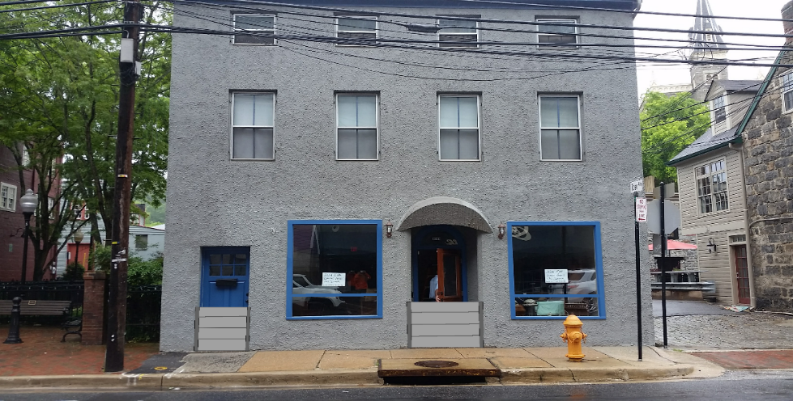
FPMS - Ellicott City, Maryland Non-Structural Flood Proofing
Partner: Ellicott City, MD
After significant flooding in Ellicott City, MD, in July 2016 and from Tropical Storm Lee in 2011, USACE partnered with Howard County, MD, to explore non-structural flood proofing solutions. The assessment included:
Data collection and building surveys
Flood proofing assessment
Preliminary economic analysis
Nonstructural flood proofing measures recommendations and concept sheets with artistic renderings and historic preservation considerations
Public outreach and public meetings
Total project costs: $154K
Federal funding: $4K
Non-Federal funding: $150K
Structural Window
Stoplog Panels
Bollards Behind Porch
Flood Door

Slide 12
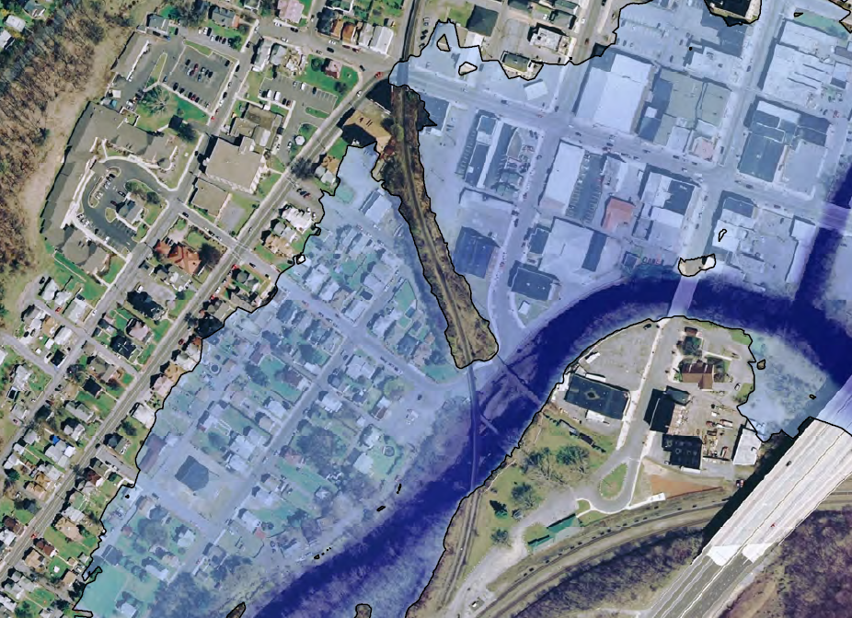
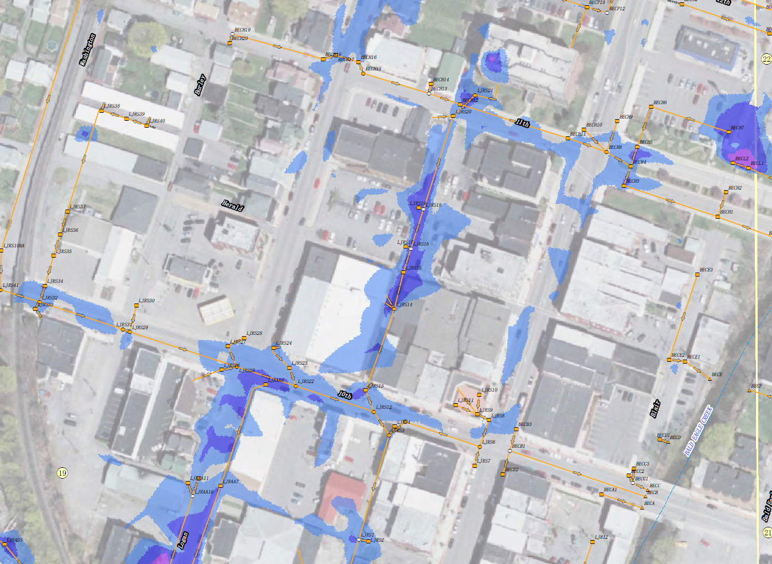
FPMS – Tyrone borough, pa flood risk assessment
Partner: Borough of Tyrone, Pennsylvania
The Borough of Tyrone, Blair County, PA, has a lengthy history of severe flooding from the Little Juniata River and Bald Eagle Creek as well as stormwater related flooding that has caused property and roadway damages. To assist the Borough in flood risk management and decision making, USACE:
Completed hydraulic and hydrologic, and stormwater modeling
Developed conceptual alternatives to address riverine and stormwater flooding In addition, Conducted building surveys
Developed a database for the building information
Total project costs: $200K
Federal funding: $150K
Non-Federal funding: $50K
Stoplog Panels

Slide 13
INTERAGENCY NONSTRuCUTURAL FLOOD RISK MANAGEMENT
Objective: Cooperative efforts that reduce human exposure or vulnerability to a flood hazard by managing consequences, with an emphasis on natural and nature-based approaches
Authority – Section 206 of the Flood Control Act of 1960
Who can participate – Tribes; Federal, State and Local governments and agencies; and/or ongoing teams and task forces
Types of Efforts – Modeling, table top exercises, evacuation planning, flood warning systems, flood inundation tools and mapping, risk communication, flood risk assessments, mitigation planning, etc.
Funding/Cost-Sharing
Without charge, subject to program funding limits
Proposals accepted annually, and funded
Caveats
</= $100,000
Interagency, including at least 2 governmental agencies
Achieve flood risk management benefits that could not be achieved by any one party alone
Nonstructural approaches focus
How to Get Started?
Contact the District or Division FPMS Program Manager

Slide 14
INTERAGENCY NONSTRUCTURAL – non-structural flood proofing workshops in Pa and md
PA Silver Jackets Partners: USACE, FEMA, PA Emergency Management Agency, PA Dept of Environment Protection, PA Dept of Community and Economic Development, PA Historic and Museum Commission
MD Silver Jackets Partners: USACE, FEMA, MD Dept of Environment, MD Emergency Management Agency, MD State Highway Administration, MD Historic Trust, MD Dept of Natural Resources, and Eastern Shore Land Conservancy
Through the PA and MD SJ teams, a series of non-structural flood proofing workshops were held in PA and MD. The workshops were help for local officials and the public to provide information on various types of federal and state programs available to assist communities and individuals with non-structural solutions to manage flood risk.
PA Workshops - $32.2K USACE & $25K work in-kind
MD Workshops - $42K USACE & $35K work in-kind
Stoplog Panels

Slide 15
INTERAGENCY NONSTRUCTURAL – Potomac river Flood inundation mapping
DC Silver Jackets Partners: USGS, NWS, FEMA, NPS, DC Department of Energy and Environment, National Capital Planning Commission
The DC SJ team developed a non-structural flood hazard mitigation tool, which is a stage inundation map library that depicts riverine and tidal flooding along the Potomac River and tidal flooding along the Anacostia River. The purpose of the tool is to inform the general public, local officials, and emergency managers of risk associated with flooding along the Potomac and Anacostia Rivers. The tool is hosted on the National Weather Service map viewer:
https://water.weather.gov/ahps2/inundation/index.php?gage=gtnd2
Total project costs: $300K
Federal funding: $100K
Non-Federal funding: $200K work in-kind
Stoplog Panels

Slide 16
Programmatic funding and innovative financing
Program Funding | Authorized Funding | FY19 Appropriation
Planning Assistance to States | $45M $15M for technical assistance $30M for comprehensive plans | $9M
Floodplain Management Services Technical Services and Special Studies Interagency Nonstructural | $50M | $17M (Total) $7M $6.3M

Slide 17
PAS and FPMS Program Specifics
PROVISIONS | PLANNING ASSISTANCE TO STATES (PAS) | FLOODPLAIN MANAGEMENT SERVICES (FPMS)
Congressional Authority | Section 22, WRDA 74 (S42 USCS § 1962d-16); Section 2013, WRDA 07; Section 3015, WRRDA 2014 | Section 206 Flood Control Act 1960; Section 321, WRDA 1990; 33 USCS § 709a; Section 202, WRDA 1999
HQUSACE Guidance | Section 3015 Implementation Guidance (June 16);Section 1032 (Dec 14); ER 1105-2-100 | Section 202 Implementation Guidance (Feb 2000); ER 1105-2-100
Appropriations Limit | (1) $30M/year for comprehensive plans (2) $15M/year for Technical Assistance (3) Not to exceed $5M per State per year | $50M/year
Per Project Limit | None Congressionally mandated | None Congressionally mandated
Project Type | Hydrologic, economic and environmental data and analyses; comprehensive water resource plans | Data and analyses for floodplains, flooding (hazard identification, prevention, etc.) and flood risks; advice to federal agencies and local interests
Cost-Share (Fed/non-Fed) | 50%/50% WIK acceptable for Comprehensive Planning Cash required for Technical Assistance | (1) 100% Federal for non-federal interests (2) Non-federal voluntary contributions to expand study scope acceptable (3) 100% cost recovery from Federal agencies and private entities.
Partners | A state; group of states; non-federal public bodies; Federally-recognized Indian Tribes; specified territories; and not for profits | Non-federal interests, Federal agencies, and private entities (corporations, sole proprietorships, etc.)
Legal Agreement and Approval | Cost Sharing Agreement or Letter Agreement | Letter Agreement required when contributed funds are being used for special studies None required for Interagency Nonstructural
Approval Authority | Division | Division
In-Kind Services | Yes, for comprehensive plans | No (FPMS technical and special studies) Yes (Interagency Nonstructural)
Contributed Funds Permissible (Non-Federal funds to expand scope) | Yes | Yes

Slide 18
Questions and Discussion
Beverly A. Hayes, Program Manager
Planning Assistance to States and Flood Plain
Management Services
Mobile District, U.S. Army Corps of Engineers
Landline: 251 391 9681; Cell: 410 320 9406
Beverly.A.Hayes@usace.army.mil

