Slide 1
Alabama Water-Use Database Overview
Brian Atkins
Alabama Office of Water Resources
Alabama Department of Economic & Community Affairs (ADECA)
October 11, 2018

Slide 2
eWater Functional Processes
Receipt of Declaration of Beneficial Use (DBU) application and completeness review
Processing, review, issuance, and transmittal of Certificate of Use once DBU review is complete
Creation of annual use reporting forms, transmittal, receipt, review, and incorporation of reported data into system

Slide 3
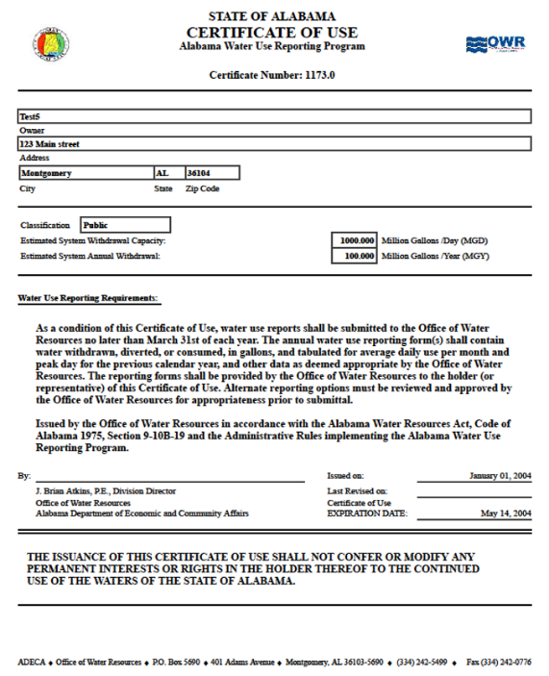
Application (DBU) Review Processes
OWR staff review for completion, information provided, and supplemental documentation and entry into eWater
Draft
Creation of draft COU

Slide 4
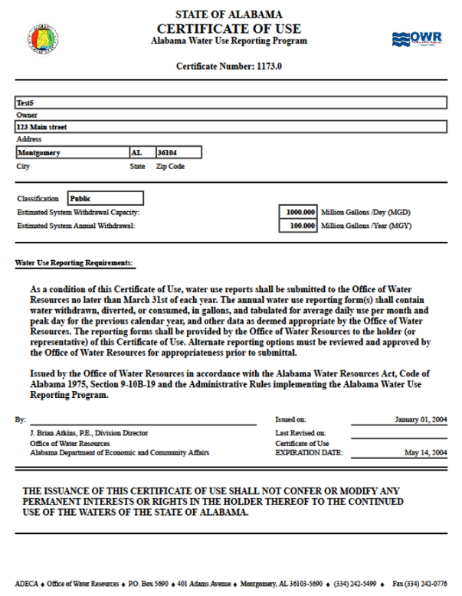
License (COU) Review/Issuance Processes
Draft
OWR staff review for compliance and required documentation
Official approval
Final
File copy and transmittal to COU holder
Signature

Slide 5
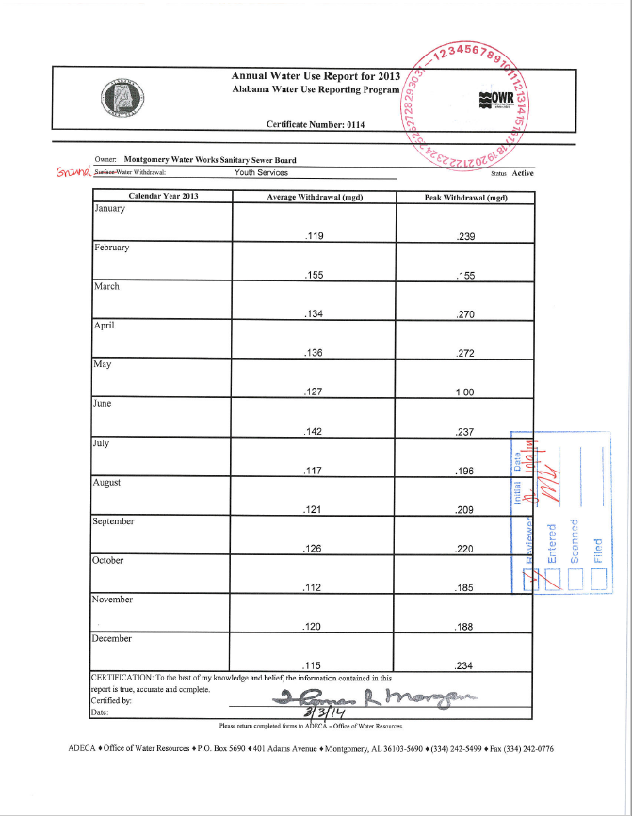
Annual Reporting Processes
OWR staff generates annual reporting forms and sends out in December
OWR staff receives annual forms (Due by March 31)
OWR staff reviews forms, submittal into eWater, and filing

Slide 6
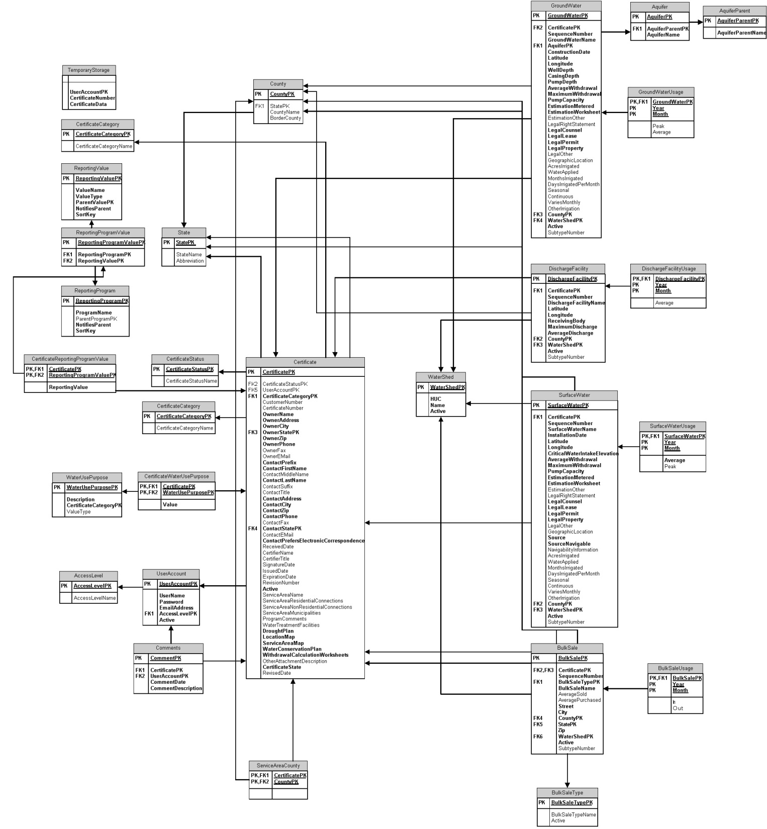
eWater SQL Database Schematic

Slide 7
Current System

Slide 8
Current System

Slide 9
Current System
OWR
eWater
Database
old and almost obsolete; limited ability to update
Form creation, processing and output
OWR Employee Input
such as DBU application and water-use reporting

Slide 10
Desired Goal
OWR
eWater
Database
new and improved
with more options!
Form creation, processing and output
Water User
Web Input such as DBU application and water-use reporting

Slide 11
Consultation with Other States
Talked with several other states regarding potential application sharing:
Arkansas
Georgia
Missouri
Oregon
Tennessee
Wisconsin
Western States Water Council
No suitable applications found but Sara Larsen (WSWC) felt this was an important issue for many states.

Slide 12
Commercial Off-The-Shelf Options
Aquarius – Aquatic Informatics
WISKI – Water Information Systems by KISTERS
EQuiS – EarthSoft
Laserfiche

Slide 13
Laserfiche
“Laserfiche is the world’s leading software for content management, business process automation, and productivity-boosting data analytics.”

Slide 14
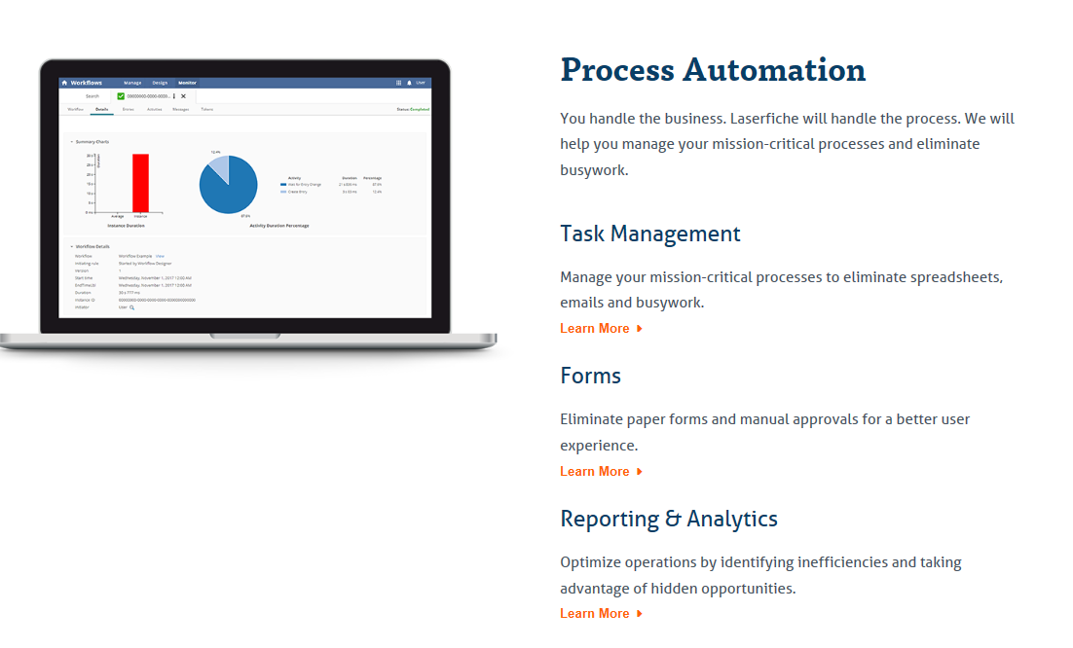
Laserfiche

Slide 15
Updated Desired Goal
OWR
eWater
Database
new and improved
with more options!
Water User
Web Input such as DBU application and water-use reporting

Slide 17
Conclusion
No easy or cheap solutions!
We will have to create a web input interface (Alabama OIT)
Develop new SQL database or use Laserfiche’s SQL database system
We realized that we needed more document processing; therefore, we chose Laserfiche (also on state contract)
We plan to use Laserfiche for some data entry, form processing, form generation, sequential approvals, and data analytics

