Slide 1
Break with Tradition Join the Technical Revolution in Water Management
James C. Schneider, PhD 2018 ICWP Annual Conference

Slide 2
Our love/hate relationship with models
Groundwater management requires groundwater models
But using groundwater models can be very difficult, because:
No model
Model too coarse
Model too cumbersome
Model doesn’t run
Can’t create model inputs
Can’t decipher model outputs

Slide 3
The complexity of the modeling process
Requires:
Expertise
Familiarity with model
Translation of inputs and outputs
Software
Hardware

Slide 4
Modeling studies completed quickly and efficiently.
Models are readily utilized.
Visualize the results in real time.
Notes:
Olsson is developing our software to help NRDs and other water managers to actively use their models and TRUST the results.

Slide 5
Any Model Can be Used in Real-time
Bringing automation technology to water management.
After model setup, even complex model runs can be completed with minimal efforts.
Time to completion only depends on model run times.
Automatically view and modify results.

Slide 6
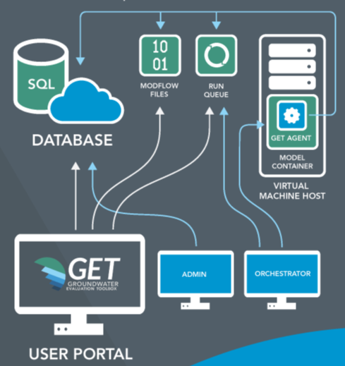
Cloud computing
Hardware and software managed for you.
All you need is an internet connection and a browser.
Data storage and recovery is never a problem.

Slide 7
How does it work?
https://getportal.olssonassociates.com
Following graphics are screenshots of the GET portal, customized for the client and created on the fly using the stored results of model simulations completed in the GET portal.
Don’t need to focus on details, these are simply examples to demonstrate the possibilities.
Notes:
To be used only if Jim feels it’s the right crowd. If not, He can stop at the previous slide and tease with the option to meet with him to discuss more.

Slide 8
NCORPE Scenario
NCORPE project purchased 115 high capacity wells.
Most of the wells retired, 30 retained for augmentation.
What is the difference in the impact given that some wells are actively used for augmentation?

Slide 9
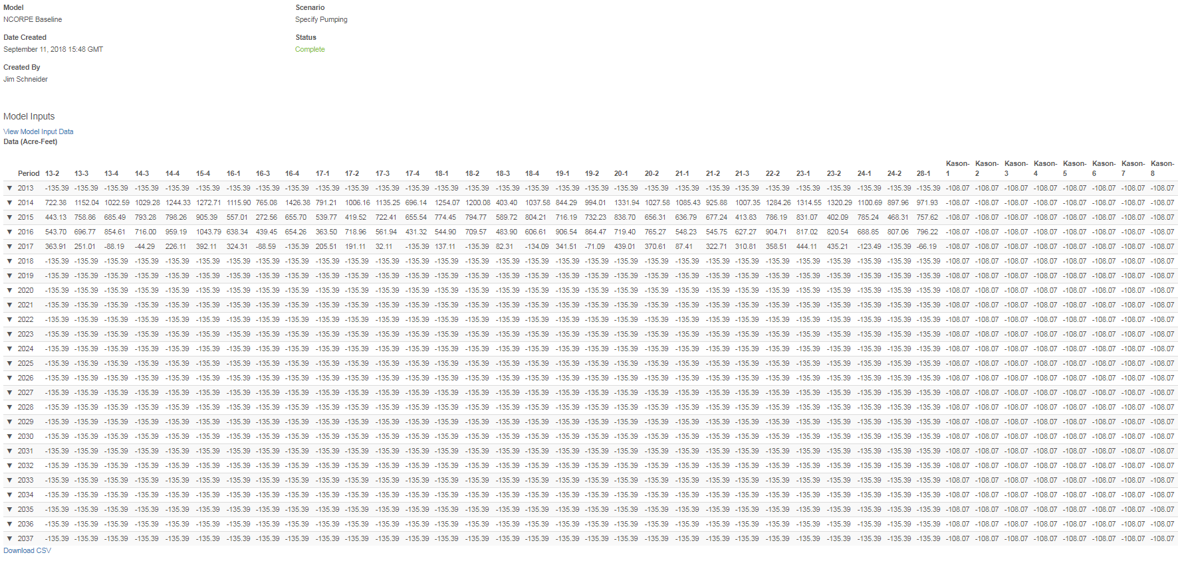
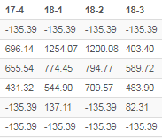
NCORPE Scenario

Slide 10
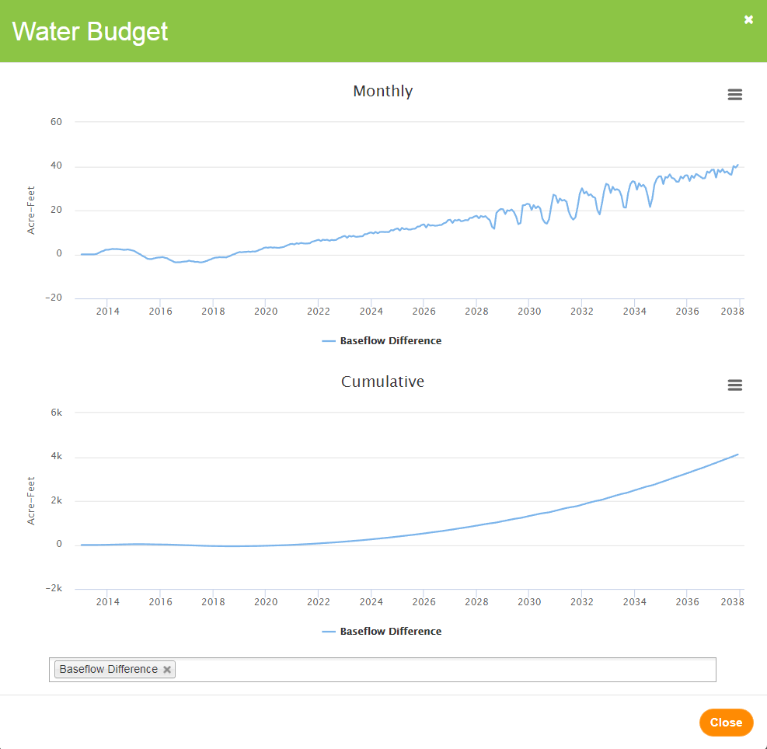
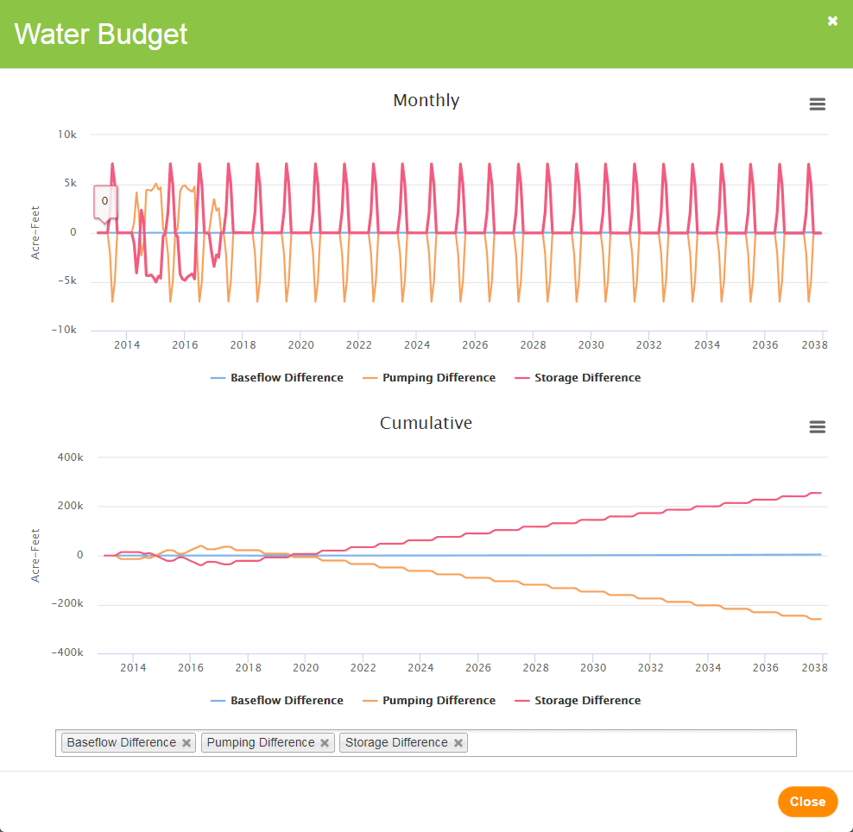
NCORPE Scenario

Slide 11
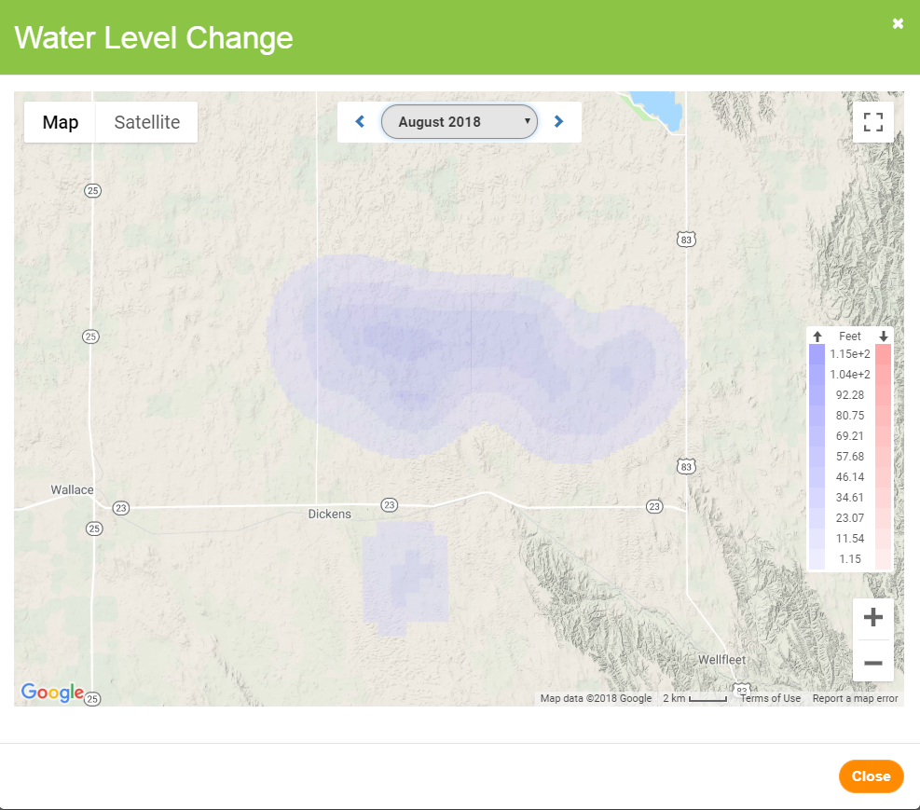
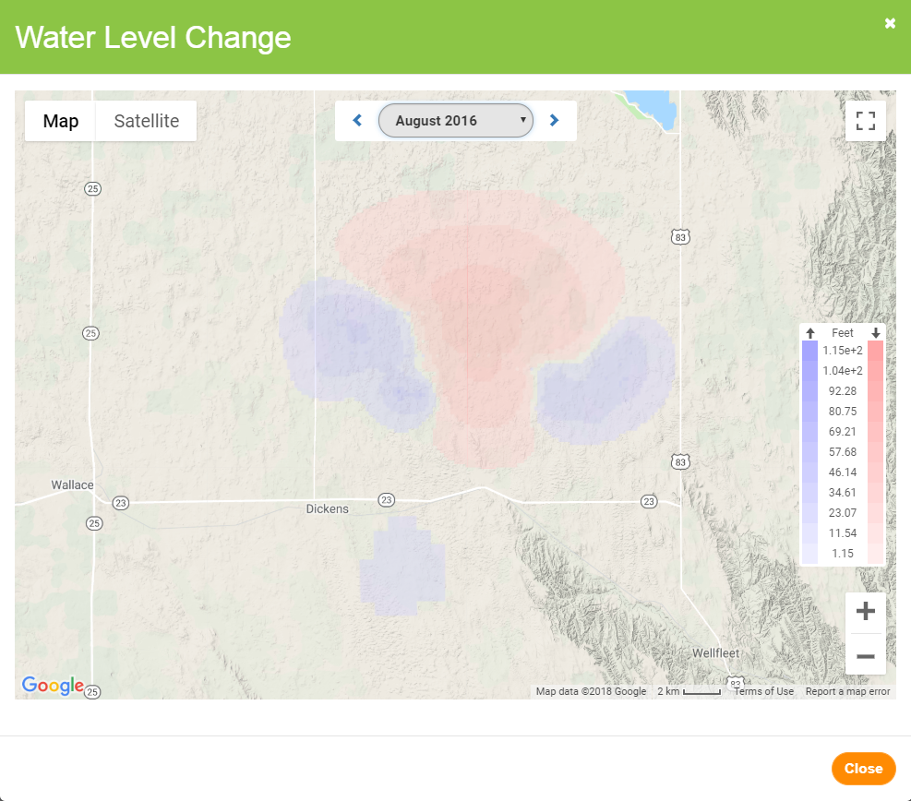
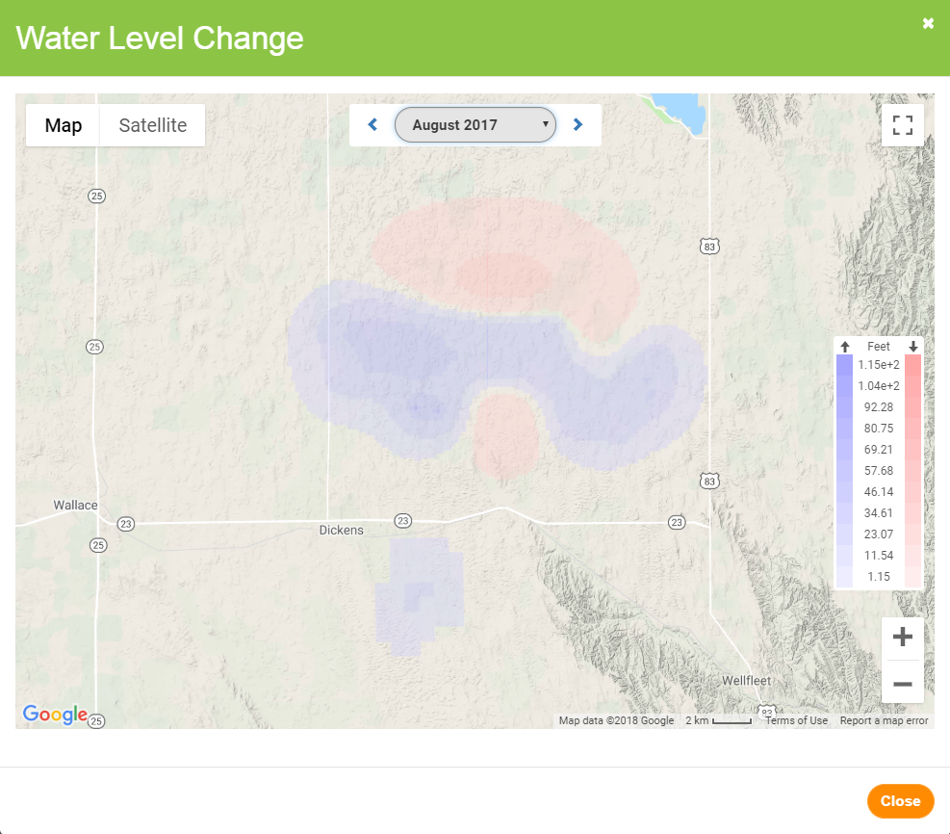
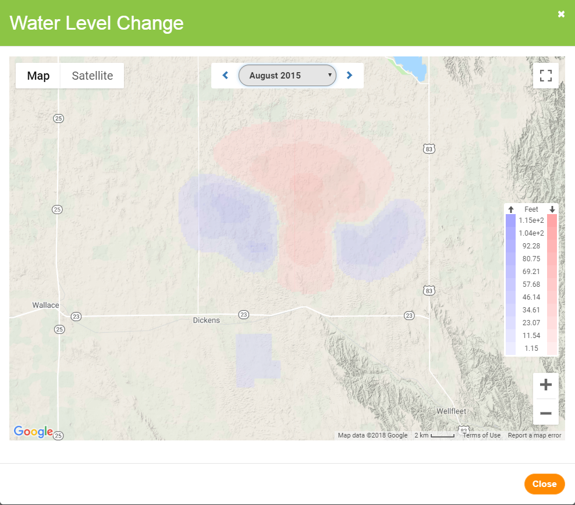
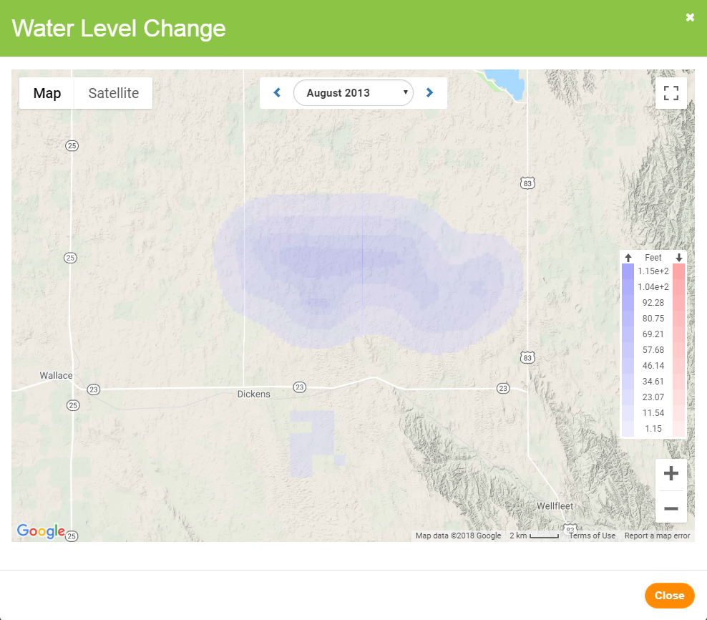
NCORPE Scenario

Slide 12
Allocation Scenario
Keith County model completed for TPNRD to simulate various water use reduction scenarios
As an example, simulated a 5% reduction in water use in each of the half-townships of interest in the TPNRD

Slide 13
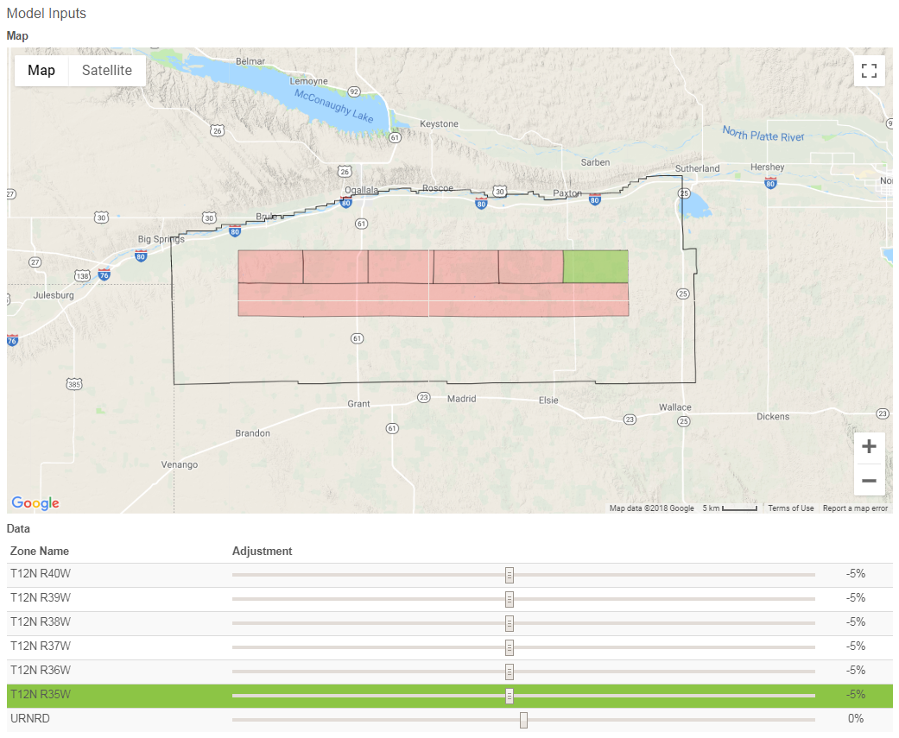
Allocation Scenario

Slide 14
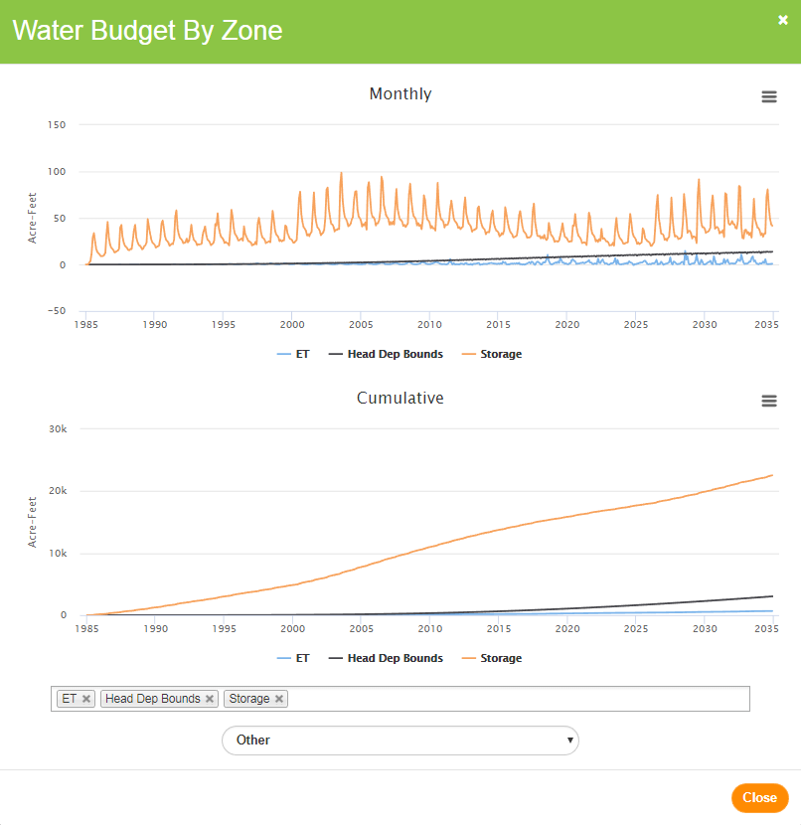
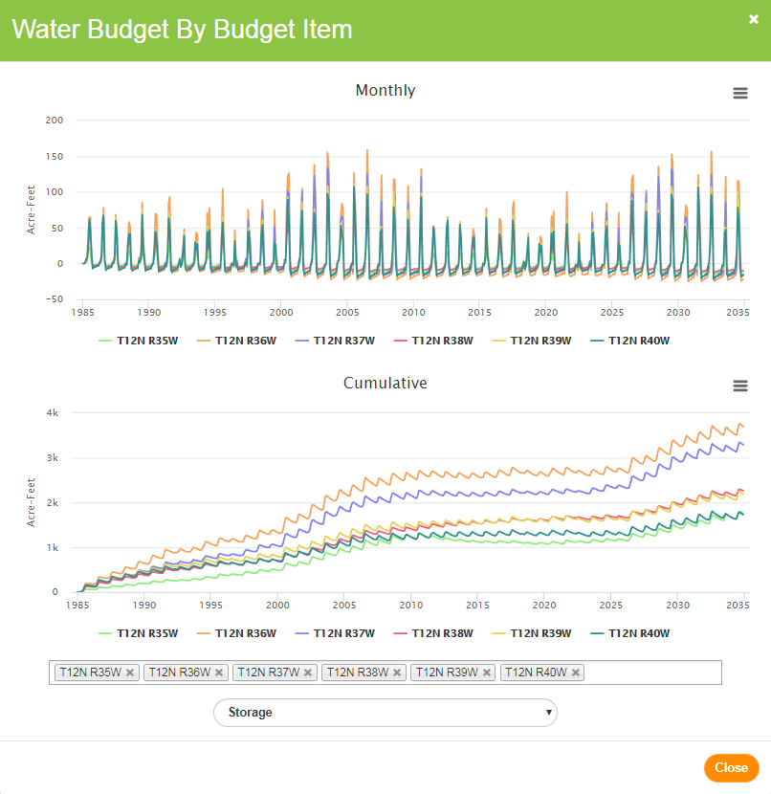
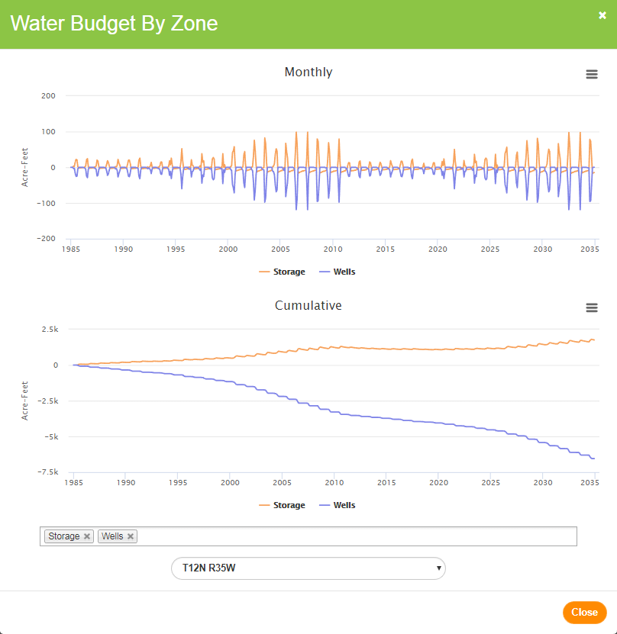
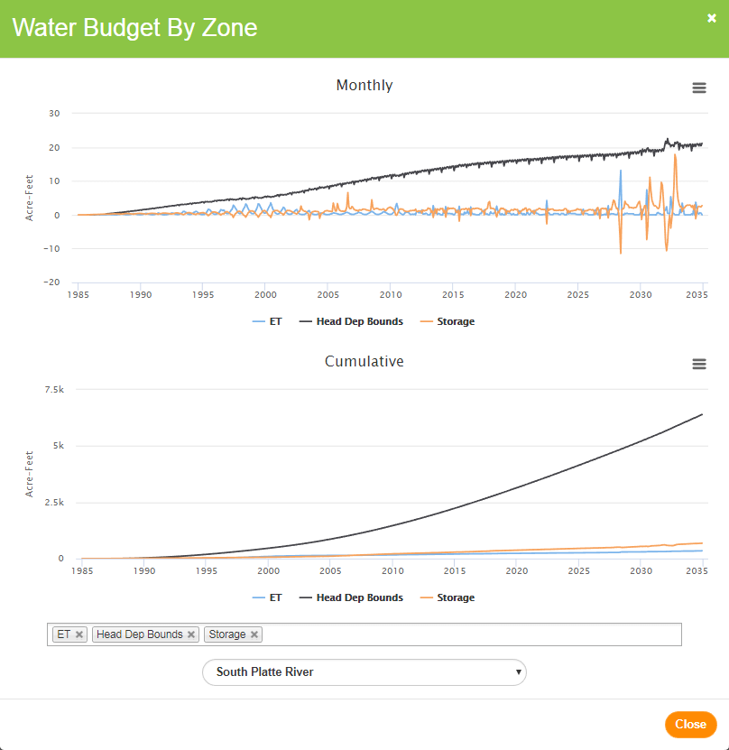
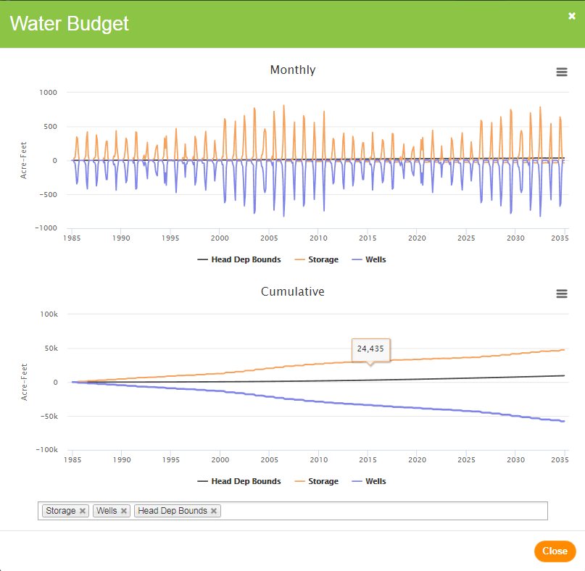
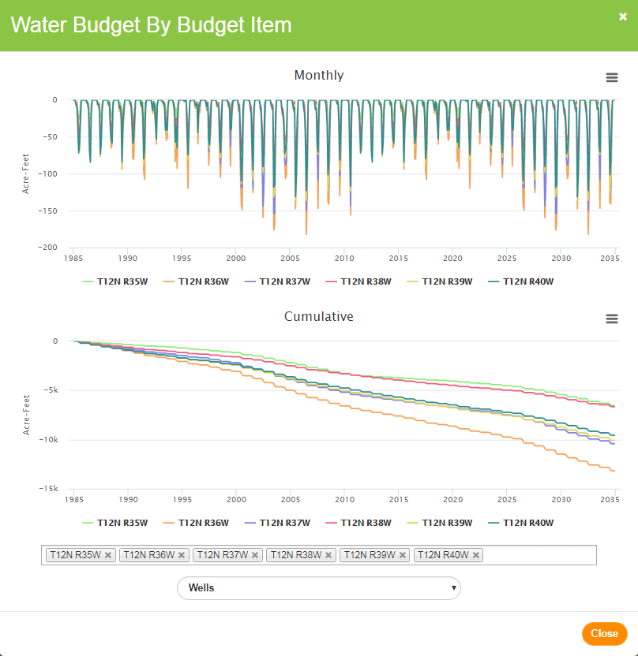
Allocation Scenario

Slide 15
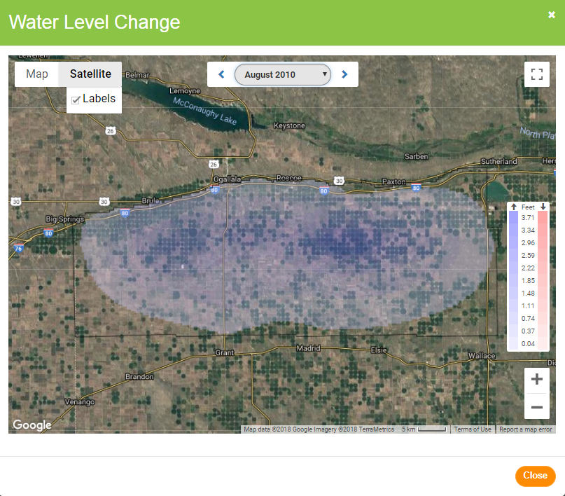
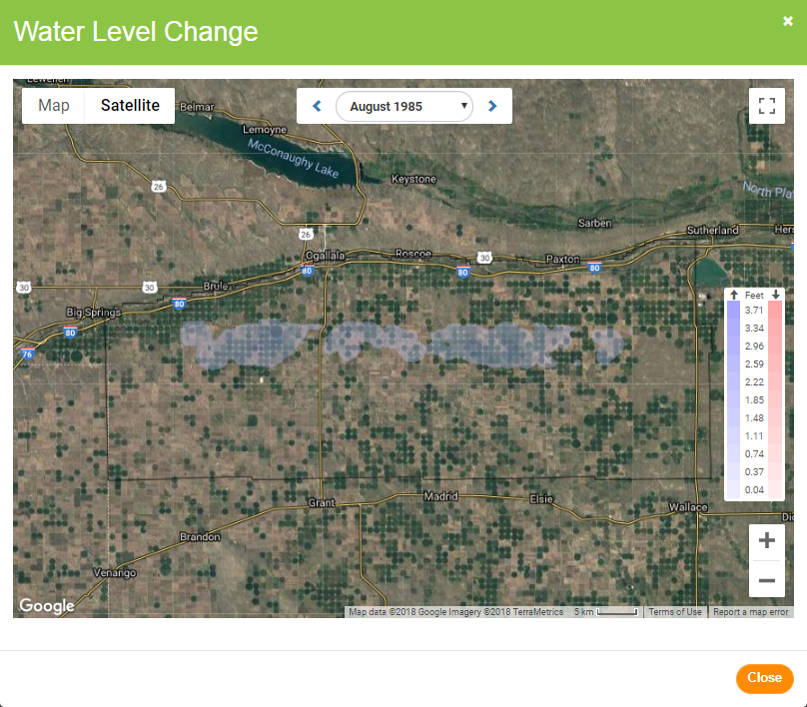
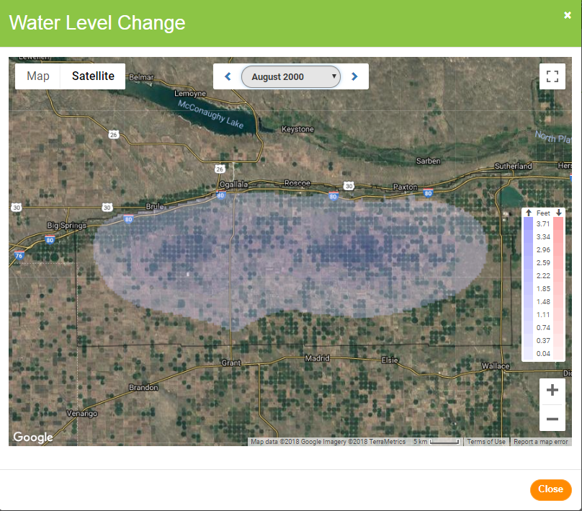
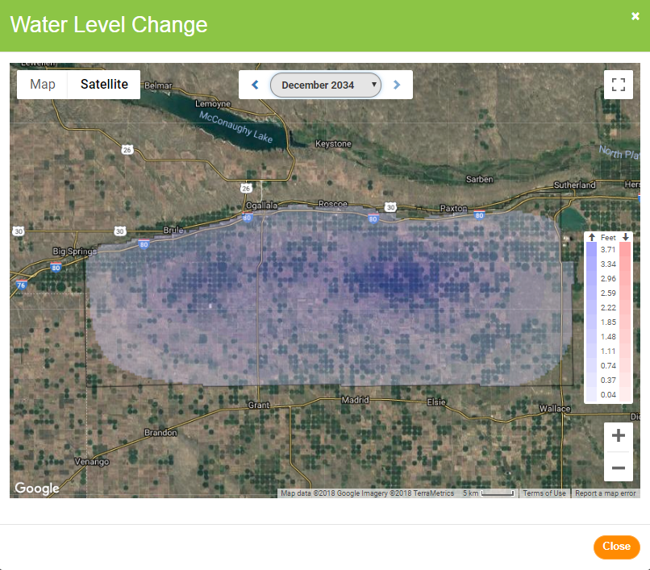
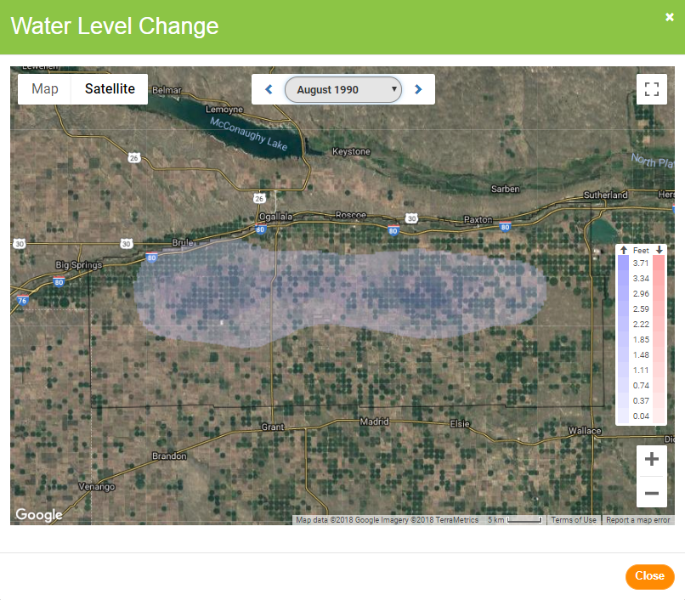
Allocation Scenario

Slide 16
Canal Recharge Scenario
Central Platte NRD model constructed to track the excess flow recharge water through the aquifer, and to simulate potential future excess flow benefits.
Run the model with the recharge that occurred on a monthly basis from 2011 through 2016.

Slide 17
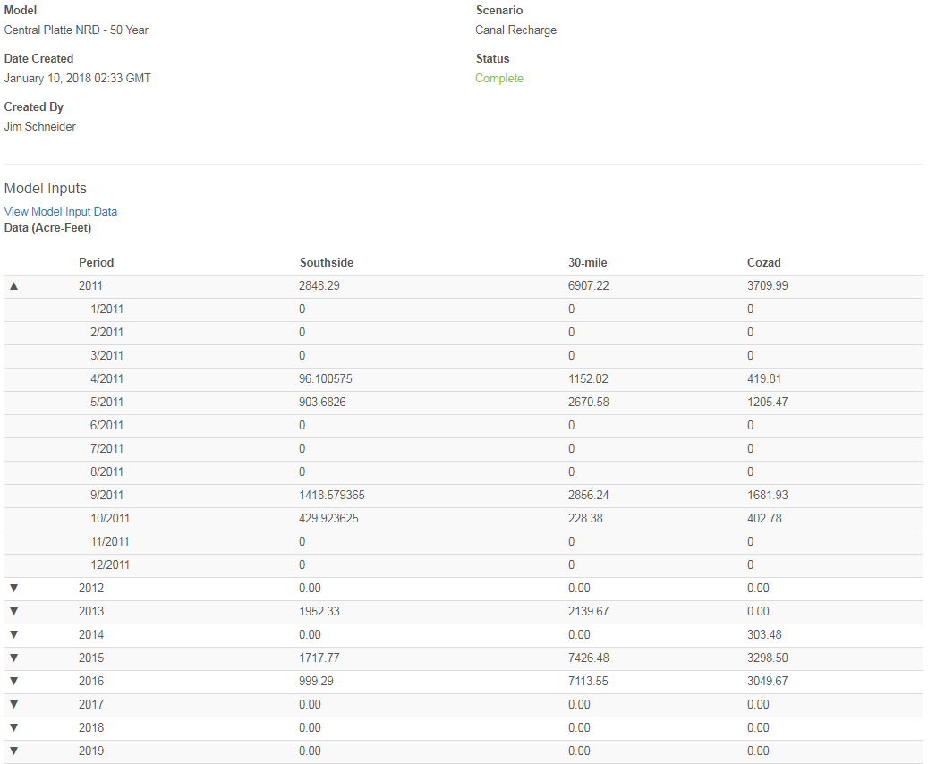
Canal Recharge Scenario

Slide 18
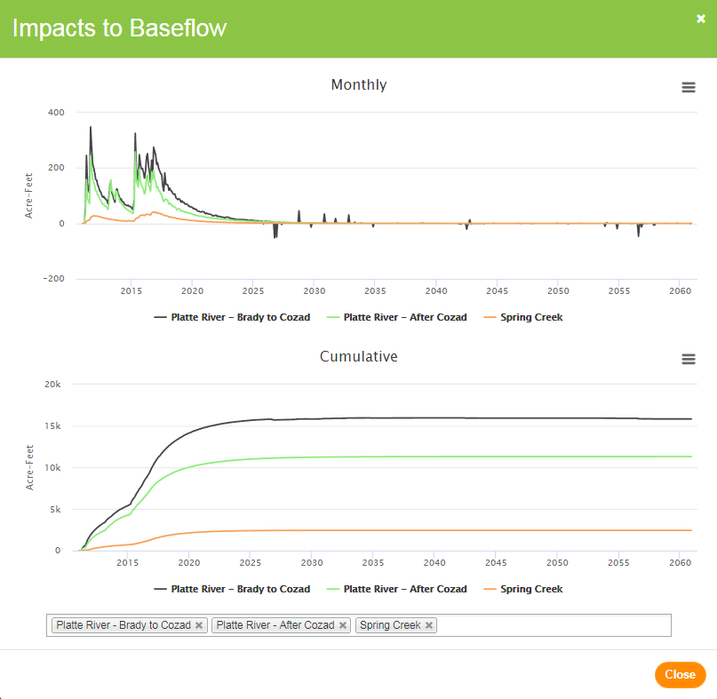
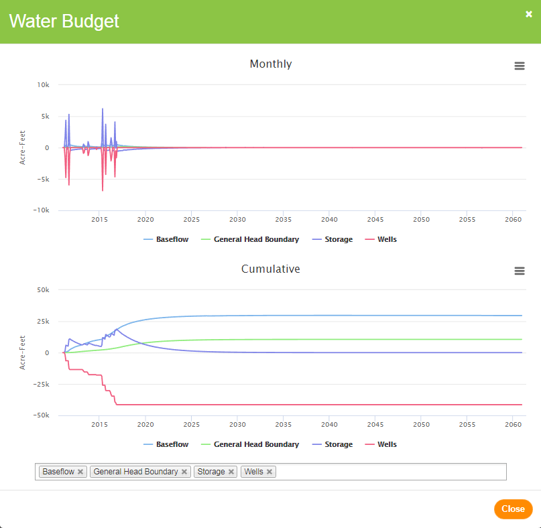
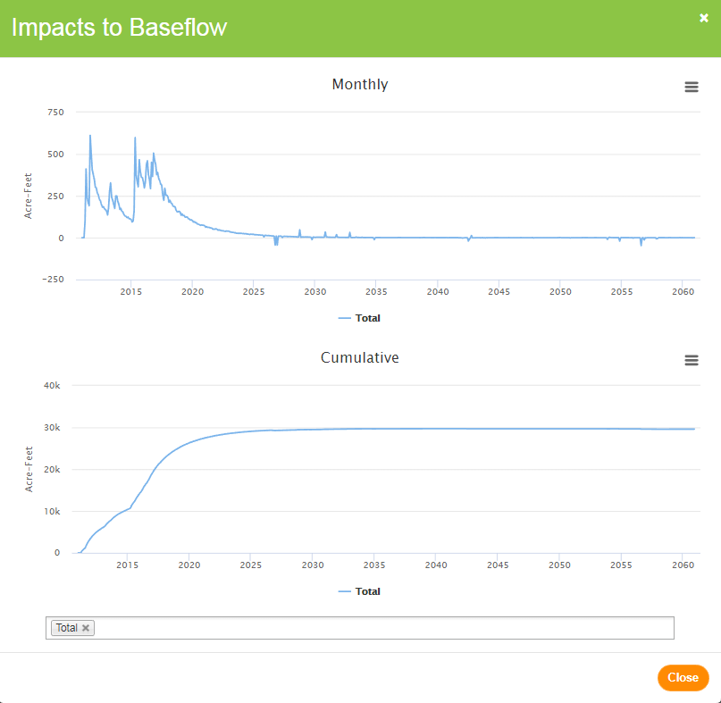
Canal Recharge Scenario

Slide 19
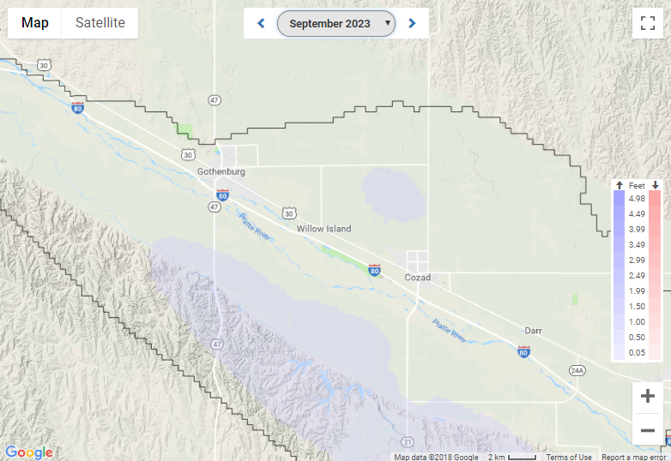
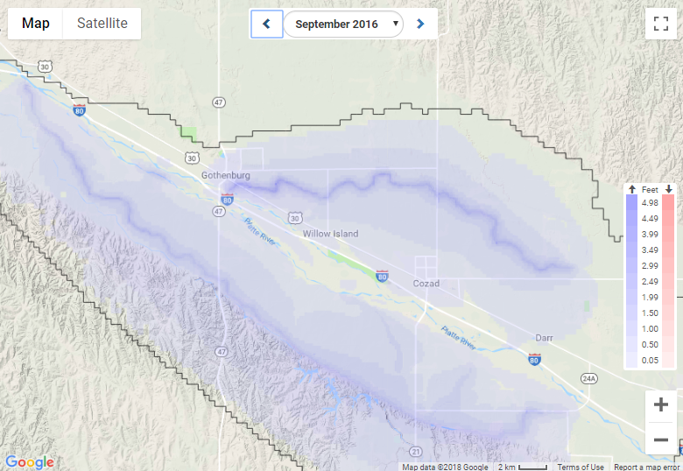
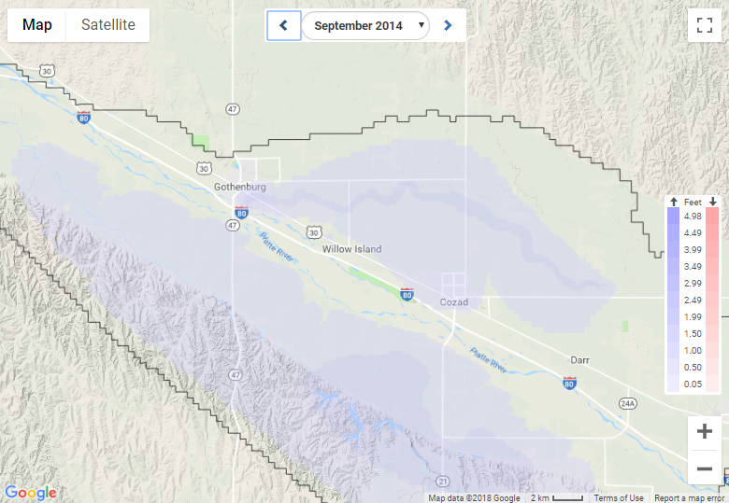
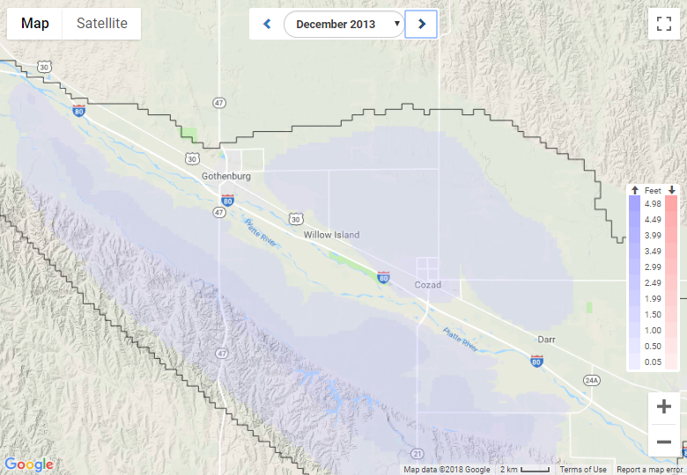
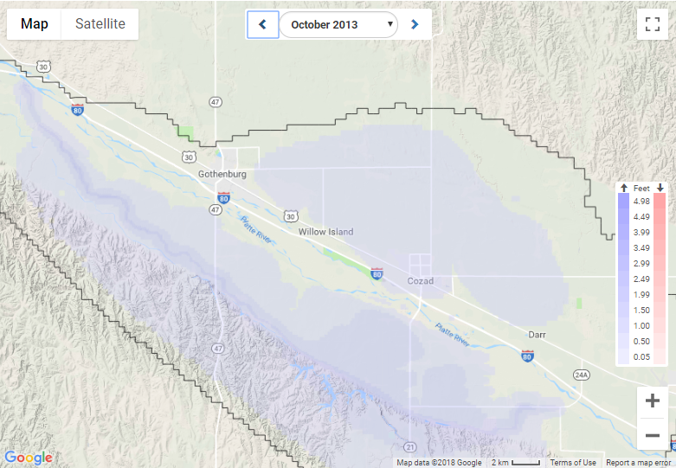
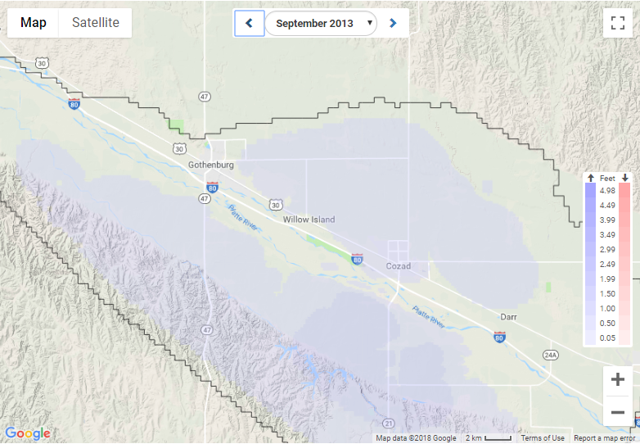
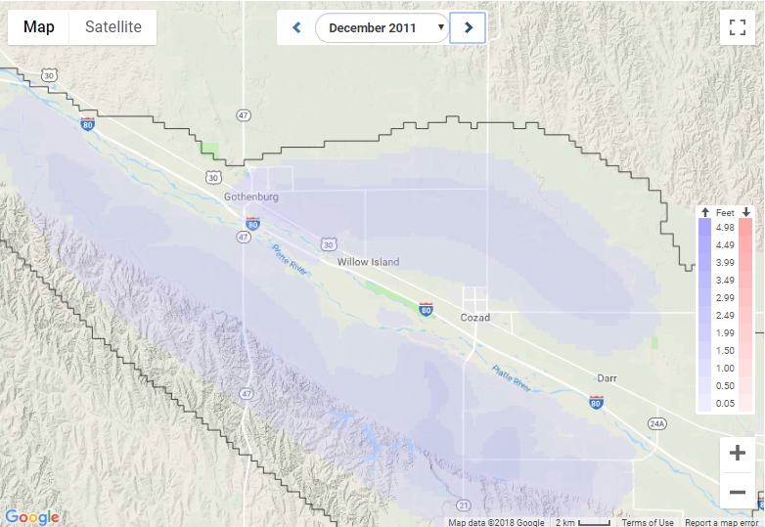
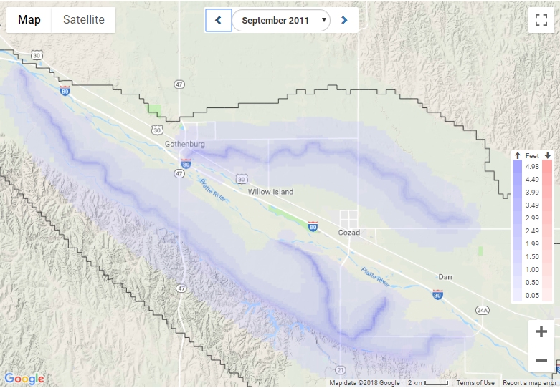
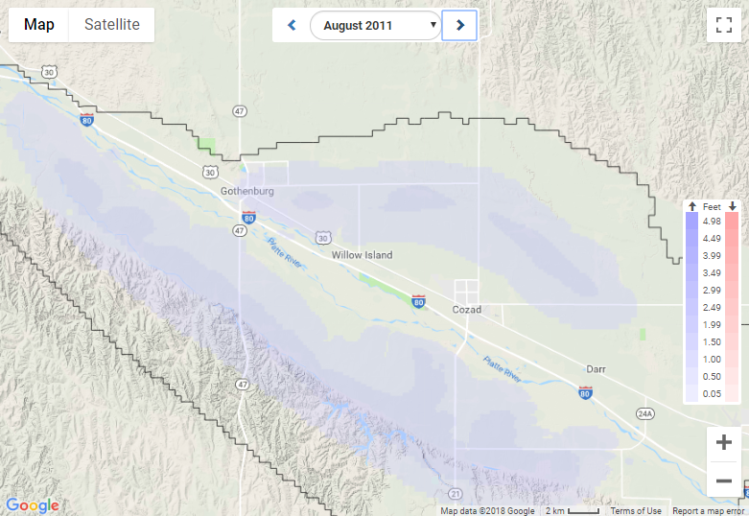
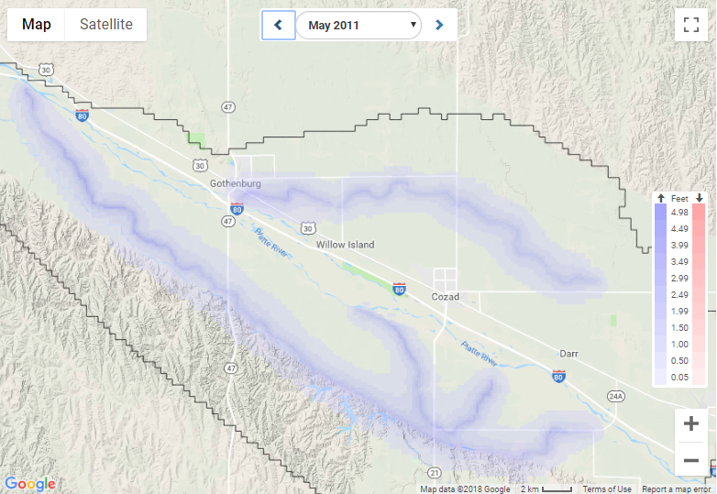
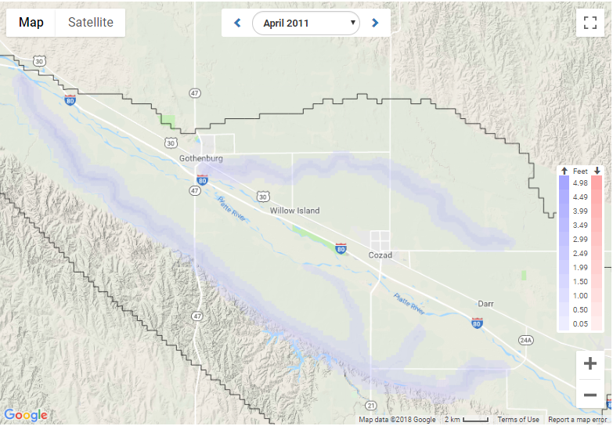
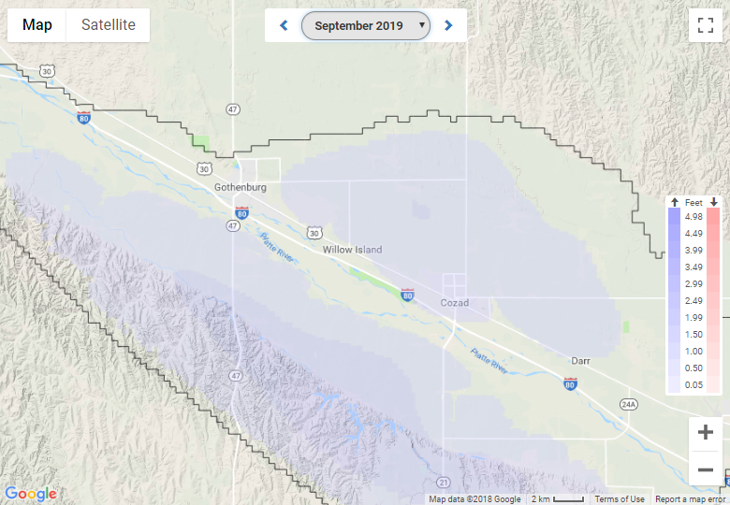
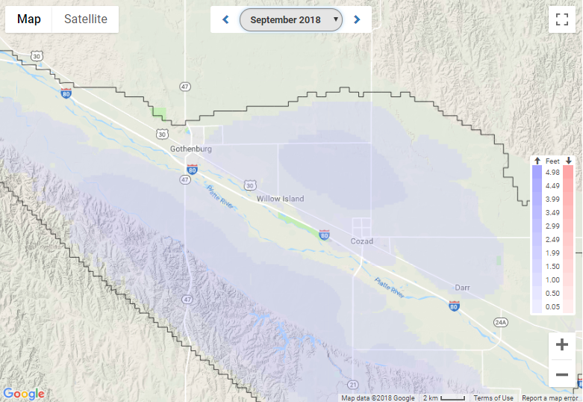
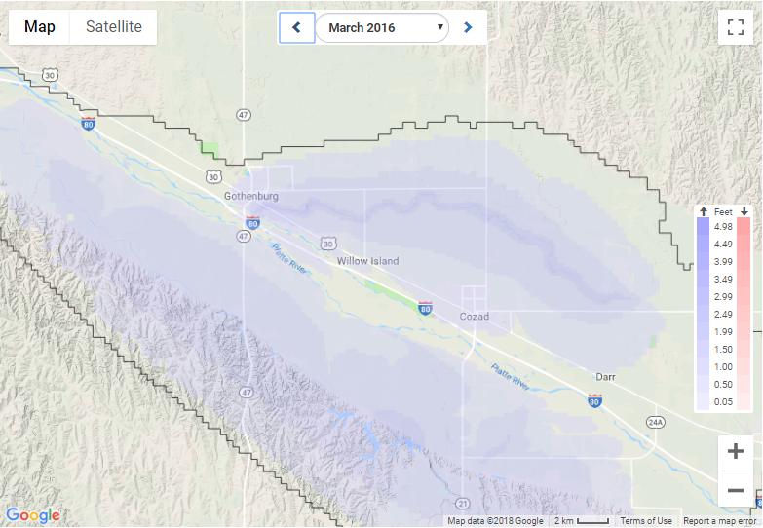
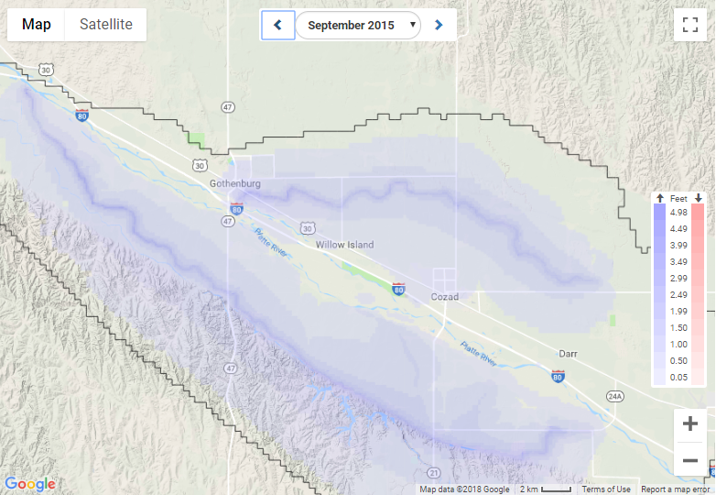
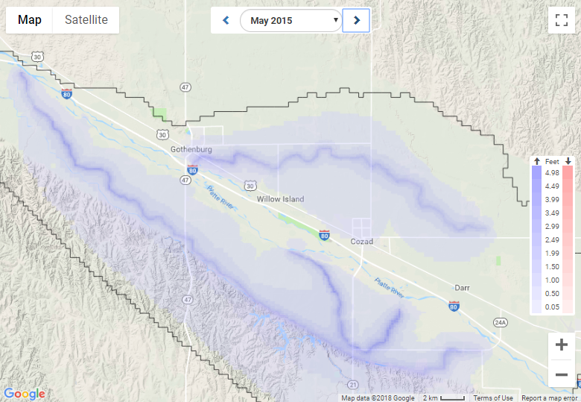
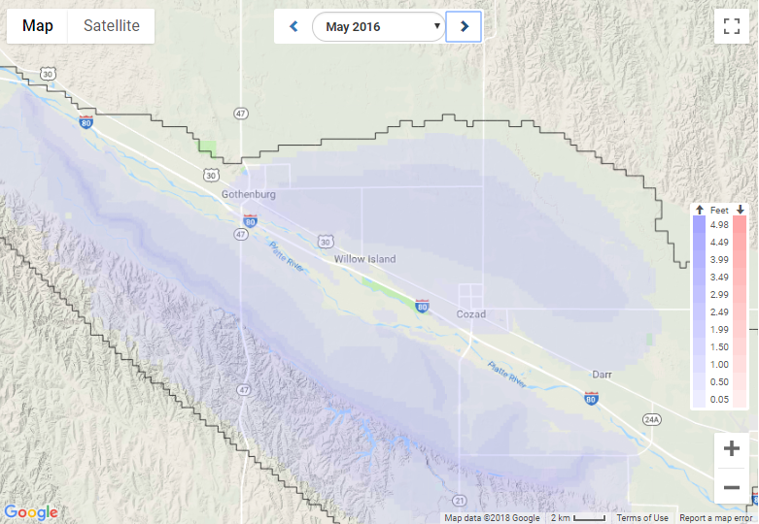
Canal Recharge Scenario

Slide 20
Permitting Scenario
The LLNRD uses SDF values, along with other criteria, to determine whether or not to approve transfer and new use applications.
After two years, they were interest in running the 68 approved transfers and 52 new uses through the model in a single model run to get the full picture of the resulting changes to the stream-aquifer system.
Year | New Acres | Transfers
2016 | 31 | 34
2017 | 21 | 34
Total | 52 | 68

Slide 21
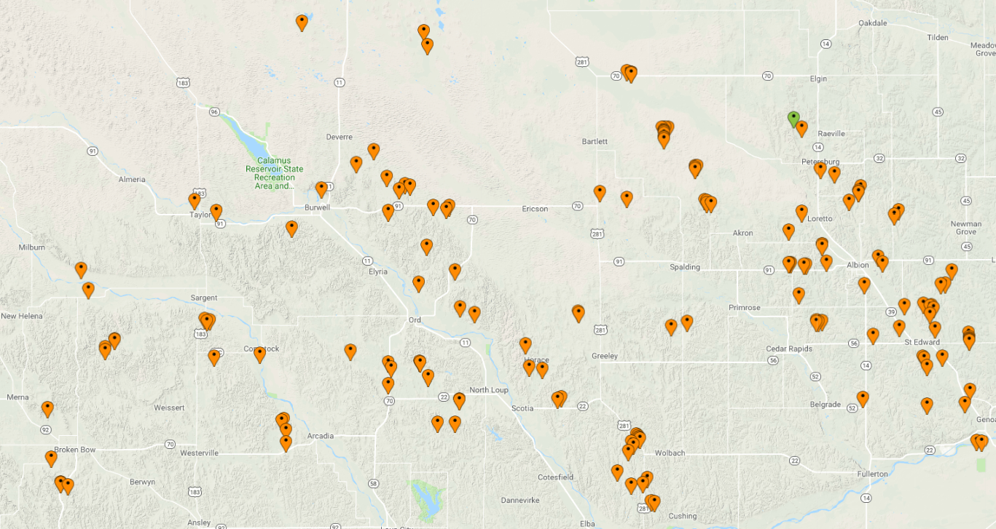
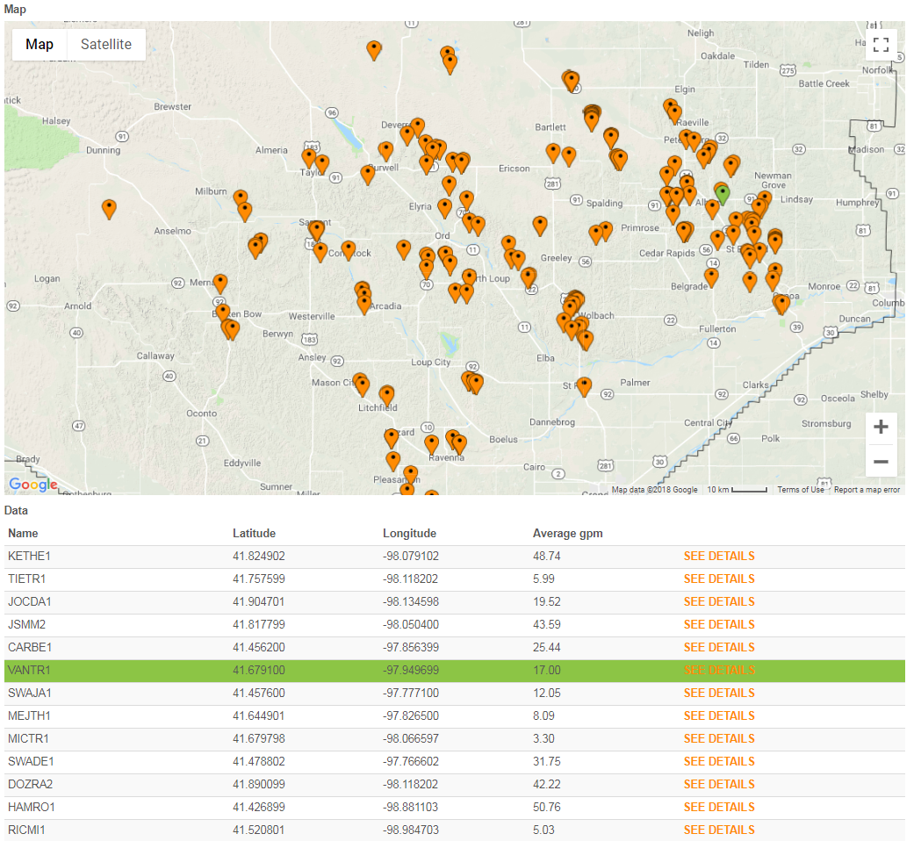
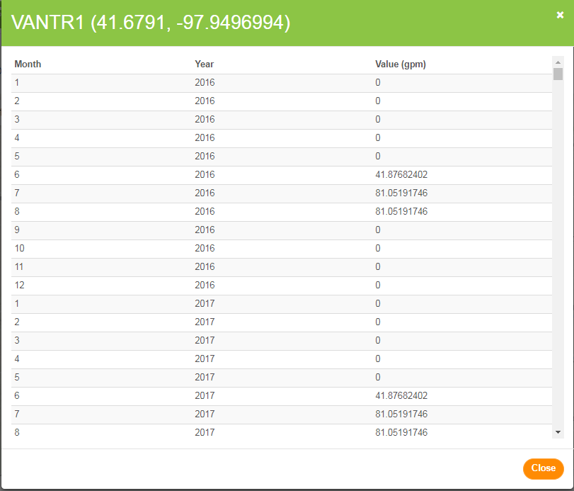
Permitting Scenario – LLNRD

Slide 22
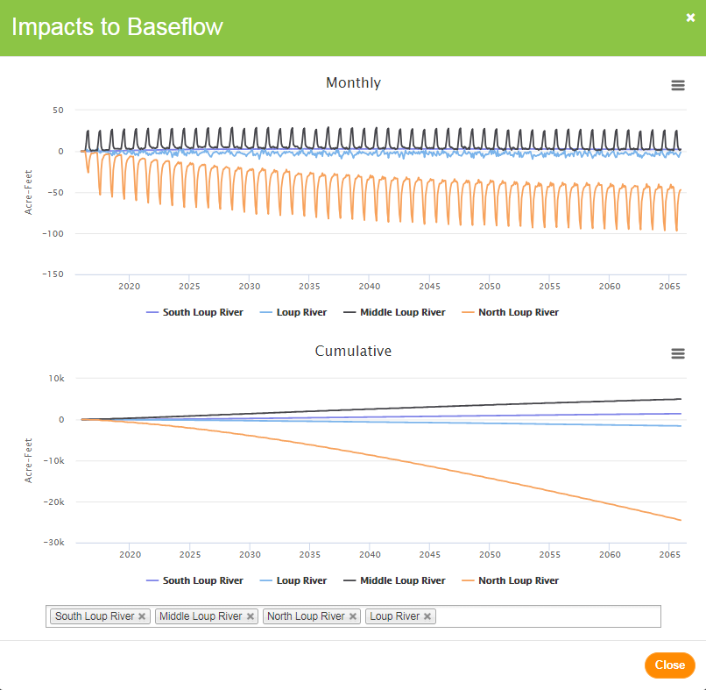
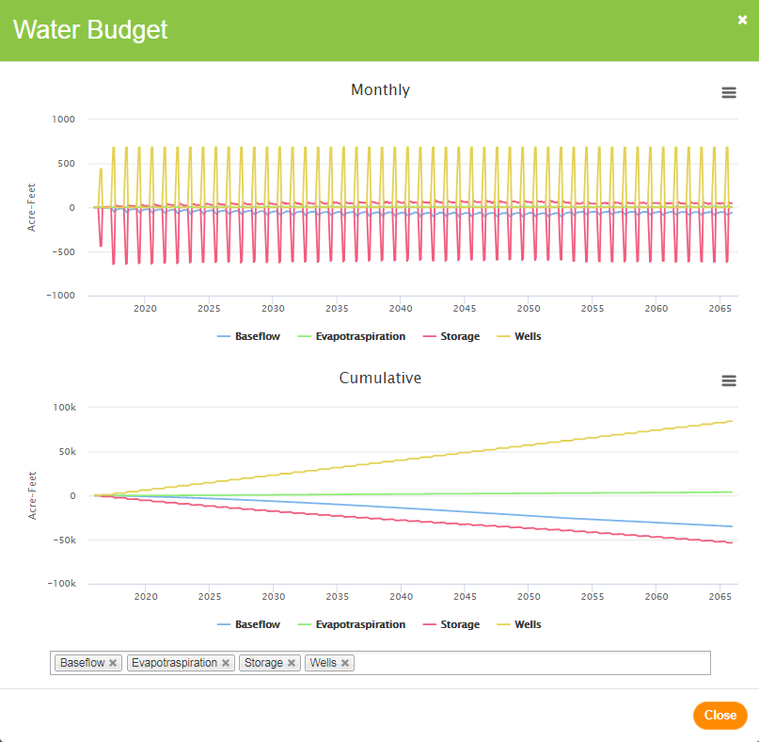
Permitting Scenario – LLNRD

Slide 23
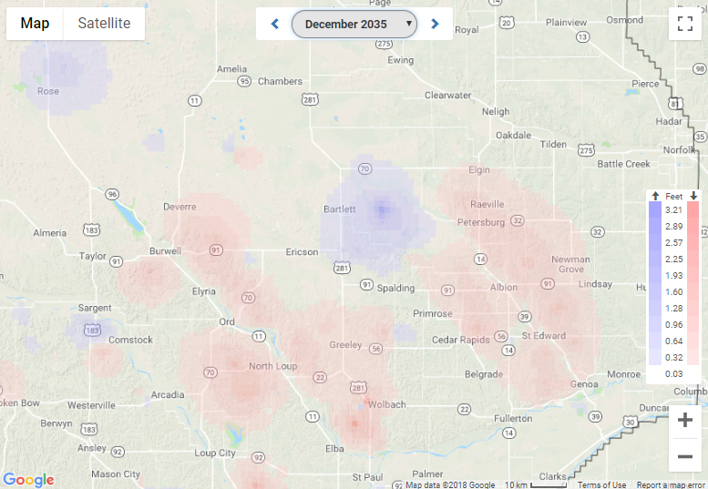
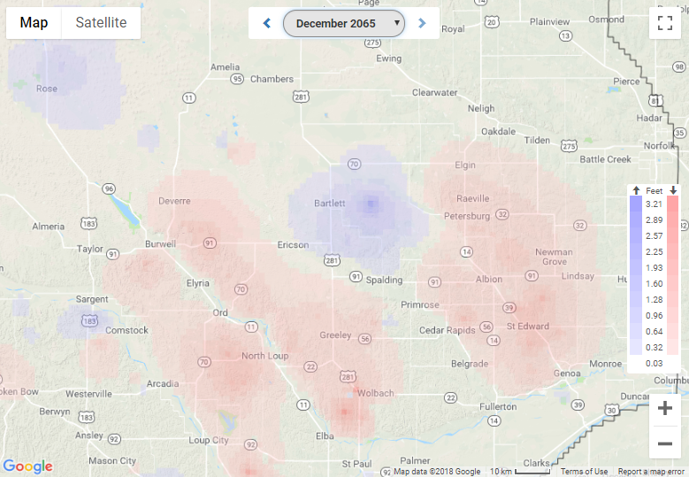
Permitting Scenario – LLNRD

Slide 24
Questions?
Jim Schneider
Olsson Associates
jschneider@olssonassociates.com
Notes:
Rear view mirror and windshield – you can see where you’re going AND where you came from.

