Slide 1
Next Generation Water Observing System (NGWOS)
Chad Wagner, Program Coordinator
Groundwater and Streamflow Information Program
Interstate Council on Water Policy Annual Meeting
October, 2018

Slide 2
Agile and Adaptive Approach to Water Observing System
“We are moving from a world in which the big eat the small to a world in which the fast eat the slow.”
Klaus Schwab, 2015 World Economic Forum
1.1 billion M2M connections worldwide in 2017
~2.6 billion M2M connections by 2020
Almost half are cellular connections
Fulton and Rejeski, 2018
Notes:
“You will have to show agility and entrepreneurship to survive the changes coming, because it will change everything.”
“What constituted a strategy 15 or even 10 years ago—
analyze, plan, execute—no longer works in operating environments
that are increasingly unpredictable, fragmented,
and characterized by high rates of technological change,
big data, crowd communication, young industries, and an
incessant drive for competitive advantage.” Martin Reeves

Slide 3
Advancements in modeling
Advanced water models can now integrate observed water data with physical process understanding, socioeconomic risk, and policy information to:
optimize water usage;
meet water-quality needs and instream flow requirements;
reduce construction costs and damages from hydrologic extremes;
provide forecasts to minimize risk and impacts from water hazards;
meet current and future water needs.
However, these models and tools require more extensive observational data than the current streamgage network can provide.

Slide 4
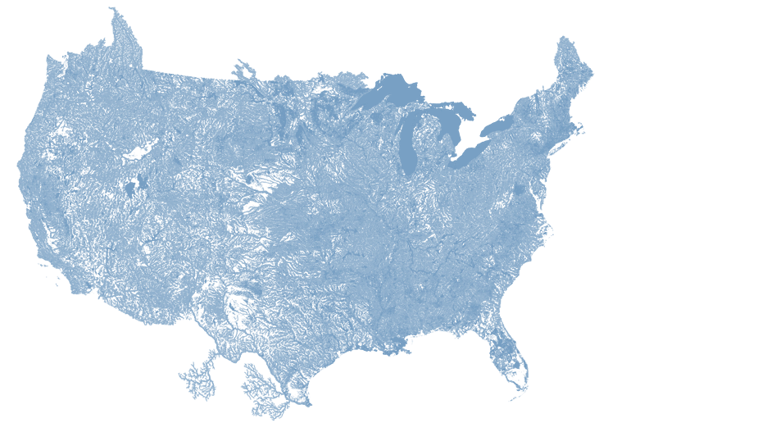
Next Generation Water Observing System (NGWOS)
The Next Generation Water Observing System (NGWOS) is part of a wider USGS plan to:
Improve and enhance our current observing and information delivery systems by providing high temporal and spatial-resolution water data in real-time.
Increase the value, relevance, and societal benefits of USGS science by supporting modern water prediction and decision support systems to address complex water challenges involving too much, too little, or poor-quality water.
Notes:
Modern models require high-density data describing all the major hydrologic components—more extensive data than the current network can provide.

Slide 5
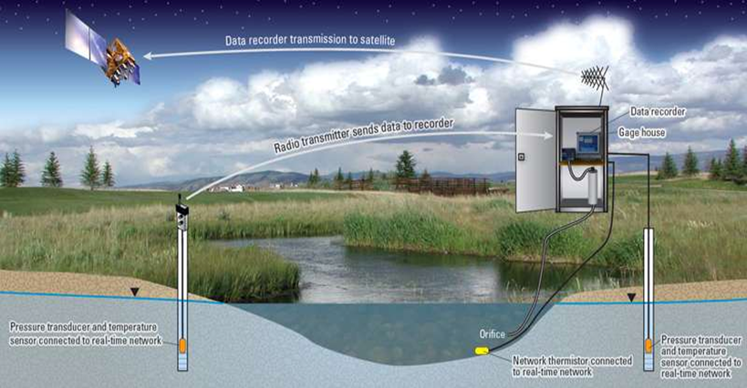
Next Generation Water Observing System (NGWOS)
When fully implemented, the USGS NGWOS will provide real-time field and remote-sensing data on:
Streamflow;
Water-cycle components (ET, snowpack, soil moisture);
Broad suite of water-quality constituents;
Connections between groundwater and surface water;
Stream velocity distribution;
Sediment transport; and
Water use.
Notes:
is

Slide 6
Beginning with the end in mind…
We can’t afford to monitor everywhere…
Implement NGWOS in ~10 watersheds that represent a wide range of basin characteristics, hydrology, and policy issues to be representative of other more modestly monitored watersheds across the nation.
NGWOS can provide high-res data to quantify and reduce uncertainty in regional and national-scale models
Leads to more accurate predictions of streamflow, aquifer levels and water-quality conditions at unmonitored locations across the nation.

Slide 7
Practical NGWOS Applications
Calibrate/validate the National Water Model and other advanced regional/national models;
Characterize and reduce uncertainty in measurements and model prediction.
These uncertainty estimates can also identify areas where additional streamgages are needed to reduce uncertainty.
This would allow for more strategic investment in long-term gages at key locations.
Notes:
Modern models require high-density data describing all the major hydrologic components—
more extensive data than the current network can provide.

Slide 8
What can NGWOS help answer?
What are the near-term and long-term risks of floods and droughts, and what scenarios change these risks?
Are we in the early stages of a drought? How long will recovery take?
How much water is stored in seasonal snow packs, and how will changes affect water supplies?
How much does groundwater contribute to streamflow, or vice-versa?
What is the quality of water and how does it change during wet/dry periods?
How long will it take for a spill to reach a location?
Notes:
is

Slide 9
NGWOS Funding
There is no plan to move funding from Federal Priority Streamgages or reallocate existing Cooperative Matching Funds to support NGWOS.
Congressional Support -- New appropriated funds have been added to the GWSIP base funding to support NGWOS.
$1.5 million in new base funding starting in FY18
$12 million new funds in House mark for FY19
Numerous floods and droughts across the Nation highlight the need for investing in long-term water information and prediction to inform decision makers and balance human and ecological needs.
Notes:
is

Slide 10
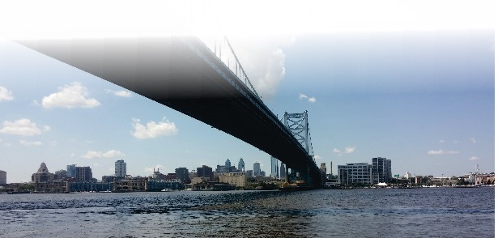
NGWOS in the Delaware River Basin
An opportunity to demonstrate an integrated water observing system to support innovative modern water prediction and decision support systems in a nationally important, complex interstate river system.
The Delaware River Basin:
Ecologically diverse and critical to the regional and national economy;
Provides drinking water to over 15 million people;
Long history of innovative, regional solutions to insure the long-term sustainability of this treasured resource.
Notes:
The Delaware River is rich in history, ecologically diverse, and critical to the regional economy. Water managers in this region have a long history applying innovative, regional solutions to insure the long-term sustainability of this treasured resource which provides drinking water to over 15 million people in the region. Piloting the NextGen water observing system in the Delaware River Basin provides an opportunity to develop an integrated water observing system to support innovative modern water prediction and decision support systems in a nationally important, complex interstate river system.
In 2018, the USGS is starting a pilot of the NextGen water observing system in the Delaware River Basin. The 2018 startup represents about 15 percent of the monitoring infrastructure needed to fully implement the NextGen observing system that can be used to test, validate, and drive water forecasts and inform water management decisions. The 2018 activities will focus on the addition of new streamgages to address critical data gaps, water monitoring network modernization, increased temperature and specific conductance monitoring, and initial steps to modernize USGS data management and delivery. Additional resources will be needed in 2019 to fully implement integrated monitoring of water quantity, quality, and use in the Delaware River Basin pilot.

Slide 11
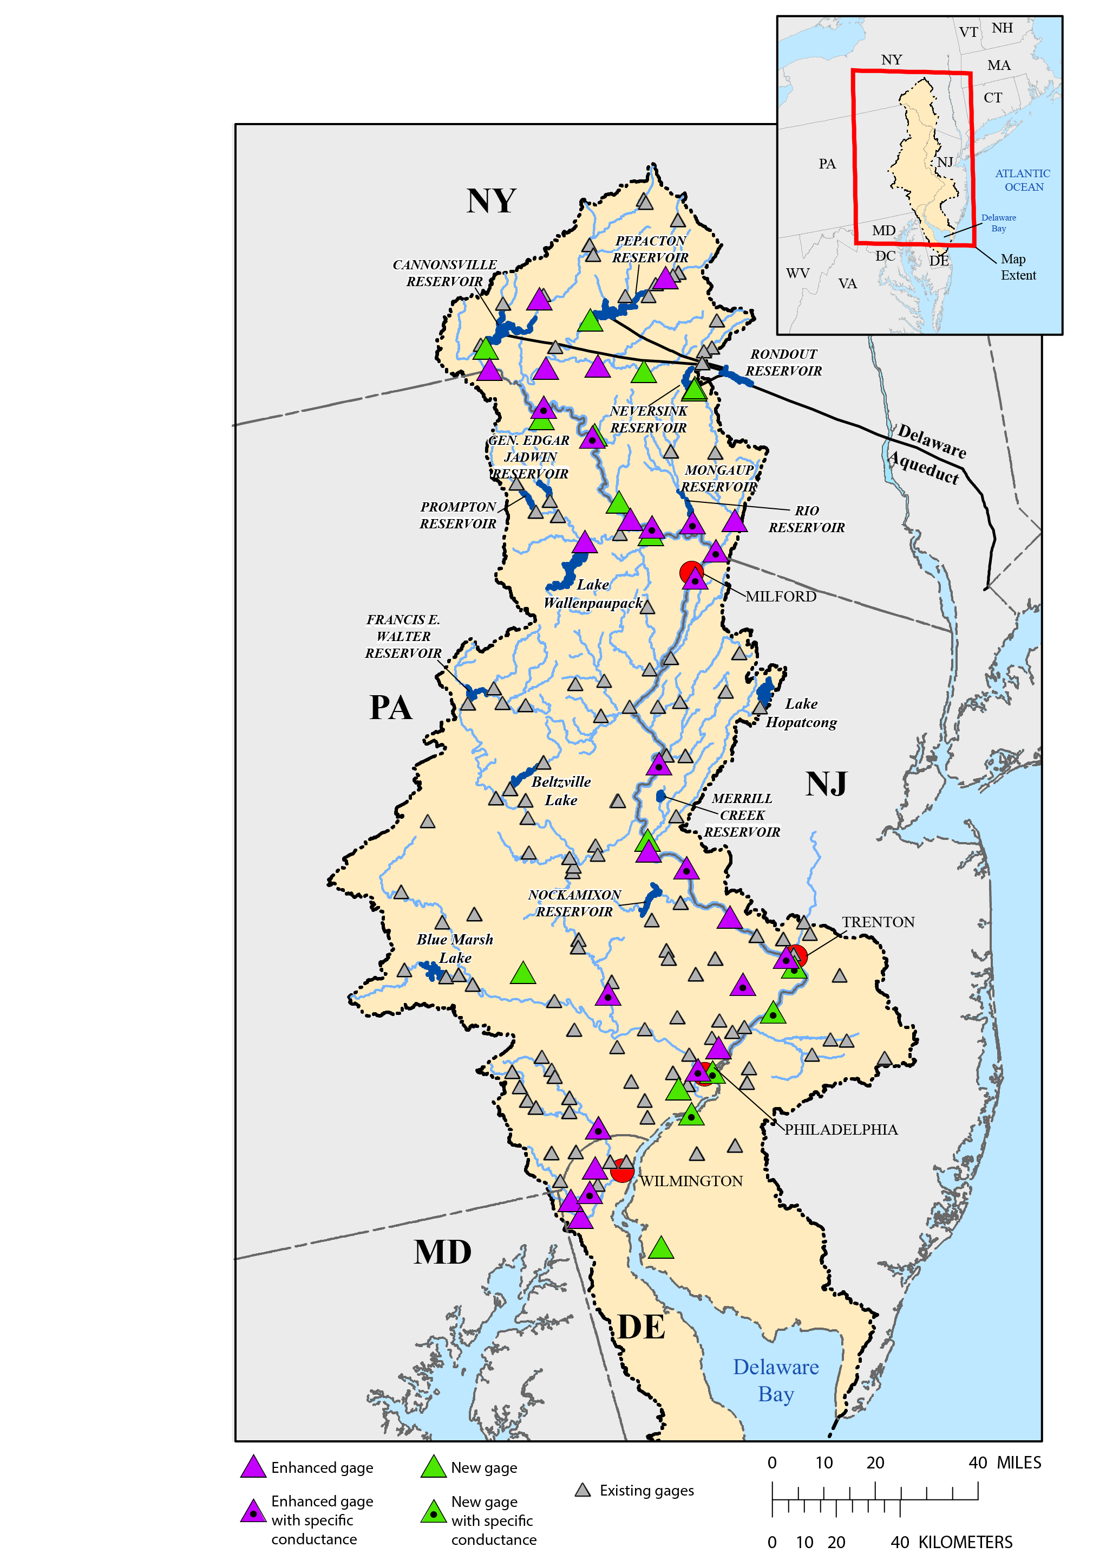
NGWOS FY18 Activities in the Delaware River Basin
Installation of 17 new streamgages;
Enhancements to 38 existing streamgages;
Addition of water temperature (25 sites)
Addition of specific conductance (10 mainstem sites)
This is initial investment represents less than 15% of the planned startup equipment investment for the complete rollout of the NGWOS in the Delaware River Basin.
Notes:
New Streamgages to Fill Critical Gaps
About 17 new streamgages will be added in the Delaware River Basin in 2018 to address key monitoring gaps to improve the quantification of the amount of
water in headwater and tributary streams and tracking of the salt front in the mainstem. These new streamgages will include NextGen communication platforms
and real-time water-temperature monitoring. Webcams will be located at selected sites
Enhancements to the Water Monitoring Network
Modernization of monitoring infrastructure at 28 existing sites will include enhanced two-way communication to enable remote operation and troubleshooting of monitoring equipment, and cellular and satellite redundancy to improve situational awareness by ensuring data are delivered during critical streamflow periods.
Webcams and plug-in water-quality sensor capabilities at selected sites will provide additional information during floods and droughts or events related to water
quality issues.
Monitoring to Support Fisheries and
Water Prediction
Real time temperature and specific conductance monitoring will provide timely information needed by multiple stakeholders to better track the salinity
front on the mainstem and track water conditions for recreational activities and fisheries management. Water temperature is a master variable influencing water
chemistry, aquatic metabolism, and the overall health of fisheries. Specific conductance information can be used to improve watershed models and predictions and understanding of surface water and groundwater connections. Real-time water temperature will be added at about 36 sites and specific conductance at about 10
sites.
The USGS will start the pilot of the NextGen water observing system in the Delaware River Basin in the late summer of 2018.

Slide 12
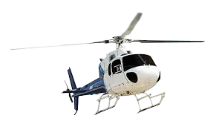
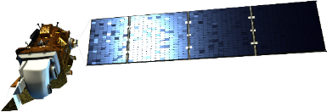
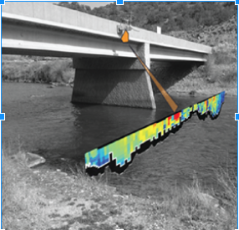
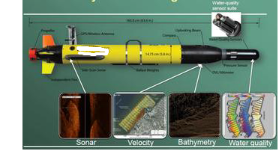
Remote Sensing
Developing new streamflow techniques to assess flows and water-quality in remote, hard to access regions

Slide 13
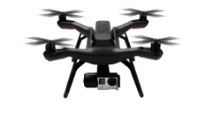
Remote Sensing
What Water Properties Can We Measure Remotely?
Water Quality
Turbidity/Clarity/Dissolved Organic Matter
CyanoHABs
Ice Cover
Temperature
Water Quantity and Fluxes
Stage/altitude and volumes* of rivers and lakes
Water surface velocities (by PIV methods)
River slope, width, and discharge*
Soil moisture
Precipitation, evapotranspiration, and recharge* and irrigation*
* - requires ancillary data that are generally available

Slide 14
Integrated Water
Availability Assessments (IWAA)
SECURE Water Act – Water Availability
Develop National Scale Indicators
Develop and Apply Predictive Tools
Integrate Assessments
Establish a core set of analyses, tools to evaluate:
Water availability for human and ecological use
Infrastructure impacts
Economic optimization
Periodic National Assessments
Range of change scenarios
Basin Specific
Stakeholder driven
Improve and Inform National Assessments

Slide 15
Integrated Water
Availability Assessments (IWAA)
Integrated Water Availability Assessments
Focus Area Studies
GW Availability Studies
Ecoflows
Drought
Water Use
Integrated Model and Tool Develop-ment
Water Quality
NexGen Observing Systems
Process Research
Notes:
In the future, WAUSP, through the NWC will work to develop an Integrated Water Availability Assessment that incorporates aspects of the Focus Area and GW availability studies, and will partner with other USGS Programs to incorporate water quality and hydrologic needs for ecological assessments.
Additionally, we will move forward on developing water use estimation techniques for irrigation, public supply, and thermo electric water use, making significant advances in water use reporting nationally

Slide 16
NGWOS Next Steps
Ongoing equipment deployment and testing in DRB
Develop NGWOS Prospectus / Plan
Stakeholder input
Concept Team and Implementation Team
Map out remote sensing, data delivery components of NGWOS
Conduct network-design and gap analysis
USGS and NOAA/NWS
Evaluate/select the next ~9 candidate NGWOS watersheds
Continued R2O into Next Gen technologies

Slide 17
Groundwater and Streamflow Information Program (GWSIP)
Chad Wagner Mike Woodside
Program Coordinator Deputy Program Coordinator
cwagner@usgs.gov mdwoodsi@usgs.gov
GWSIP: usgs.gov/gwsip
Water Watch: https://waterwatch.usgs.gov
GW Watch: https://groundwaterwatch.usgs.gov
Water Alert: https://water.usgs.gov/wateralert/parameters/
Water Mobile Data: https://m.waterdata.usgs.gov
StreamStats: https://streamstats.usgs.gov/ss/
Flood Event Viewer: https://stn.wim.usgs.gov/fev/
Flood Inundation Mapper: https://fim.wim.usgs.gov/fim/

Slide 18
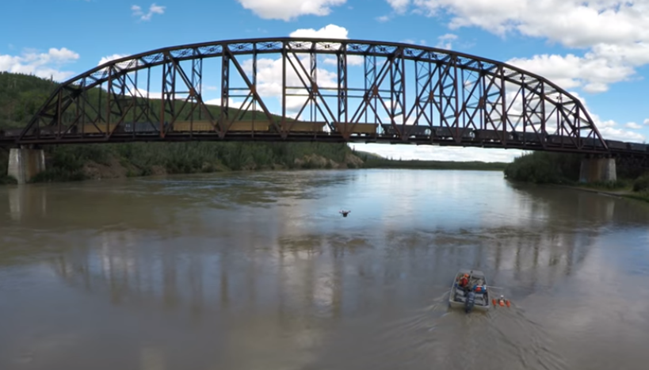
Questions/Discussion

