Slide 1
Legislation Supporting IWRM in Nebraska:
Bringing Together Prior Appropriation and Correlative Water Rights
ICWP September 30, 2019
Jennifer J. Schellpeper
Water Planning Division Manager

Slide 2
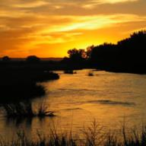
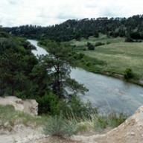

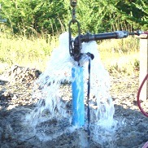
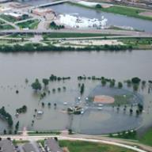
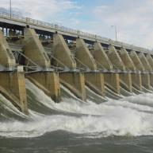
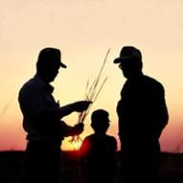
Water Planning and Integrated
Management
Surface Water
Floodplain Management
Providing the sound science and support for managing Nebraska’s most precious resource
Groundwater
Dam Safety
Field Offices

Slide 3
Water Planning and Integrated
Management
Surface Water
Floodplain Management
Providing the sound science and support for managing Nebraska’s most precious resource
Groundwater
Dam Safety
Field Offices

Slide 4
Overview
Background – Describing the Challenge
  Nebraska Water History
Keys to Success – Legislative Toolbox
  Clear Boundaries
  Local Needs
  Nested Tiers
  Dispute Resolution
  Funding
  Monitoring
  Stakeholder Participation (Trust and Communication)
Concluding Thoughts

Slide 5
Background, History of Water –
Nebraska Legislation Supporting IWRM
1996
LB 108: Joint Action Plans; NRDs can regulate groundwater to protect streamflow
2010
LB 862: Occupation taxing authority
LB 764: Provisions for voluntary IMPs
1972
Natural Resources Districts created
1889
Prior appropriation system adopted
1920
Prior appropriation part of NE Constitution
1850s
First record of irrigation ditches
1963
Bill to consider wells within 50 ft of stream part of the surface water system
1983
LB 198: Recognized intentional and incidental recharge on canals
2007
LB 701: Interstate forecasting requirements & IMP funding source
Pre-1963
Surface water and groundwater managed separately
1867 to 1889
Riparian Doctrine
1840’s
1850’s
1860’s
1870’s
1880’s
1890’s
1900’s
1910’s
1920’s
1930’s
1940’s
1950’s
1960’s
1970’s
1980’s
1990’s
2000’s
2010’s
1940s
Beginning of significant groundwater development
1978
NE Legislature reexamines water policy
2004
LB 962: Integrated management of hydrologically connected water
2009
LB 483: Constraints on development
LB 54: IMPs need methods to track use changes
1867 to 1933
Essentially no groundwater law, except on artesian wells (1897)
1967
The NE State Water Plan initiated
1895
State Administrative Control & State Board of Irrigation
1933
Landowner has correlative rights to groundwater
1981
LB 326: State Water Planning and Review Process
2014
LB 1098: Water Sustainability Fund criteria
Notes:
Nebraska Water law has a long history from the first record of irrigation ditches in the 1850’s to present day
These boxes represent some of the significant legal milestones for the creation of the initially separate SW and GW regulatory systems and the more recent Integrated Water Resources Management legislation.
State of Nebraska owns the water – citizens have a right to use the water – Commons: natural resources accessible to all members of a society; natural resources managed for individual and collective benefit
We will now look at some of the details

Slide 6
Background, History of Water –
Nebraska Legislation Supporting SURFACE WATER
1895
State Administrative Control & State Board of Irrigation
1963
Bill to consider wells within 50 ft of stream part of the surface water system
1850s
First record of irrigation ditches
1867 to 1889
Riparian Doctrine
1840’s
1850’s
1860’s
1870’s
1880’s
1890’s
1900’s
1910’s
1920’s
1930’s
1940’s
1950’s
1960’s
1970’s
1889
Prior appropriation system adopted
1920
Prior appropriation part of NE Constitution
Notes:
Surface water regulation was really set in 1889 when the Prior Appropriation system was adopted in Nebraska
State Board of Irrigation – Regulator of SW
This was further reinforced in 1920 when Prior Appropriation was made part of the Nebraska Constitution.
Surface water and Ground Water were legally regulated completely separately until 1963 when a glimmer of recognition of their hydrologically connected physical nature is recognized by a statutory change that recognized wells located close to a stream should be part of the surface water system
State of Nebraska owns the water – citizens have a right to use the water – Commons: natural resources accessible to all members of a society; natural resources managed for individual and collective benefit

Slide 7
Background, History of Water –
Nebraska Legislation Supporting GROUNDWATER
1963
Bill to consider wells within 50 ft of stream part of the surface water system
1867 to 1933
Essentially no groundwater law, except on artesian wells (1897)
1840’s
1850’s
1860’s
1870’s
1880’s
1890’s
1900’s
1910’s
1920’s
1930’s
1940’s
1950’s
1960’s
1970’s
1933
Landowner has correlative rights to groundwater
1940s
Beginning of significant groundwater development
1972
Natural Resources Districts created
Notes:
Ground water regulation was really set in 1933 when a lawsuit determined that a landowner has correlative rights to GW
In the 1940 significant GW development began
The LOCAL Natural Resource Districts were formed in 1972 – GW Regulators

Slide 8
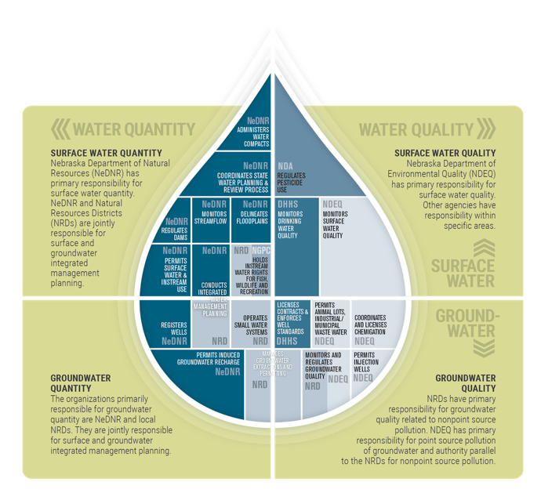
Background, History of Water –
Nebraska Legislation Supporting WATER PLANNING
1981
LB 326: State Water Planning and Review Process
1967
The NE State Water Plan initiated
1960’s
1970’s
1980’s
1990’s
2000’s
2010’s
1978
NE Legislature reexamines water policy
Notes:
Early water law for WATER PLANNING:
1981- State Water Planning and Review Process – Nebraska developed a decentralized water planning system both via State Agencies and with Local NRDs
Requires annual report
Policy issue studies – recommendations
Problem analyses and area planning – continues today as Water Planning
So, now we’ve set the stage or foundation for integrated water management planning in Nebraska –
Two separately regulated systems – groundwater and surface water
And Decentralized Water Planning

Slide 9
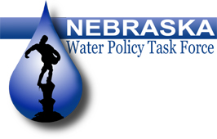


Background, History of Water –
NE Water Policy Task Force
Created in 2002 by the Nebraska Legislature
  Consensus-based decision-making process
  Evaluate law governing integrated water management
  Inter- and intra- state lawsuits
Developed LB962 (2004)
  Recognized hydrologic connection of surface and groundwater
  Established joint planning process (IMPs)
  Goal to sustain a balance between water use and water supply
Notes:
Why are the Policies Established in LB962 Important?
A 49-member Governor appointed task force that represented all of the broad water related interest in Nebraska developed LB962. The task force, using a consensus-based approach, unanimously recommended and supported the implementation of LB962 in 2004.
LB962 represented a compromised solution to establish a comprehensive policy framework that recognized the hydrologic connection between surface water and groundwater, preserved state and local authorities of surface water and groundwater, established a joint planning process (integrated management plans (IMPs)) that has the goal of sustaining a balance between water uses and water supplies so that the economic viability, social and environmental health, safety, and welfare or a river basin can be achieved and maintained for both the near term and long term, and provided for increased flexibility and protections for existing water rights.
Broad support from the Nebraska Farm Bureau Federation, Nebraska Attorney General’s Office, and other participants and observers in the development of LB962 believed that it was paramount to develop comprehensive policies that ensured the courts were not determining water policy outcomes in Nebraska.
Quote from Nebraska Farm Bureau Federation testimony before the Natural Resources Committee “If we do not develop and implement LB962, we leave policy, perhaps, up to the courts and we in Nebraska Farm Bureau are very uncomfortable having the court determine our water policy, so we encourage the Legislature to take action on LB962 and be the guiding force, be the proactive force, to develop water policy for the state.”
LB962 contained provisions to ensure that the controls contained in an IMP will ensure protection of existing surface water and groundwater users from new uses and compliance with interstate compacts and agreements.
Summary of Changes Resulting from LB962
Recognize hydrologic connection of surface and groundwater
Establish proactive approach to integrated management
Goal to sustain a balance between water use and water supply
Use the best science available
Use adaptive management
Protect investments of existing water users from adverse impacts of over use
Address conflicts between surface and ground water users
Develop a plan suited to the local values and physical conditions of the basin

Slide 10
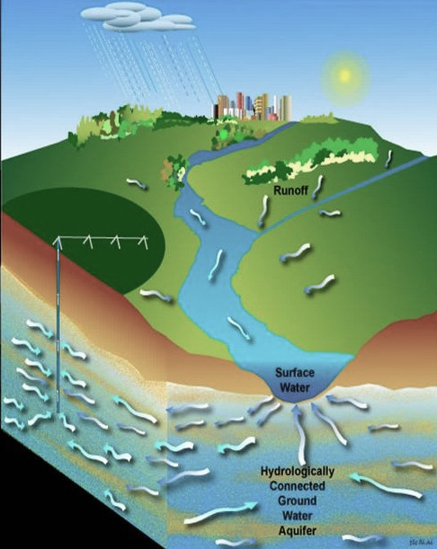
Background – Surface Water and Ground Water Quantity Authorities
Surface Water
Regulated by NeDNR
Prior appropriations
First in time is first in right
Integrated
water
management
Groundwater
Regulated by NRDs
Correlative rights
Share and share alike
Notes:
Planning for and managing surface water and groundwater supplies as one resource was historically a challenge because of Nebraska’s statutory guidelines for regulation and administration of surface water and groundwater.
IWRM brought the two regulatory systems together, while maintaining the separate authorities of both the State NeDNR and the Local NRDs
The State of Nebraska owns the water
Users do not own the water, but rather own a right to use the water

Slide 11
Background, History of Water –
Nebraska Legislation Supporting IWRM
2010
LB 862: Occupation taxing authority
LB 764: Voluntary IMPs
2007
LB 701: Interstate forecasting requirements & IMP funding source
1960’s
1970’s
1980’s
1990’s
2000’s
2010’s
2004
LB 962: Integrated management of hydrologically connected water
2009
LB 54: transparency and economic development -
IMPs must contain methods to track water use changes
2014
LB 1098: Water Sustainability Fund
Notes:
And things don’t stop evolving in 2004, of course!
Since then the law has continued to adjust to meet the needs of the local basins:
Forecasting requirements & IMP funding source WRCF $3.3M / year today + $3.3M NET funds
Transparency for economic development – tracking new uses and any offsets
Voluntary IMPs – (Program 19 funds) dedicated funds to the Water Planning Division for studies and planning needs. $400,000 / year today +current staffing levels 17 FTEs ~ $1.5M annually
Increased Funding
NRD taxing authority
State Cash Funds

Slide 12
Keys to Success – Legislative Toolbox
Elinor Ostrom’s
Principles for Managing a Commons
Nebraska Water Planning
Clear boundaries
Rules match local needs and conditions
Affected user participate in rule making
Local rules respected by outside authorities
Member system to monitor
Graduated sanctions for violators
Accessible dispute resolution
Nested tiers of governing responsibility
Effective communication & trust
Clear boundaries (1)
Decentralized water management (2,4)
Stakeholders (2,3)
Monitoring (5)
Dispute resolution process (7)
Nested tiers (8)
Trust and communication (9)
Notes:
Commons: natural resources accessible to all members of a society; natural resources managed for individual and collective benefit
“The NRDs adhere to principles for sustainable management of common pool resources developed by Elinor Ostrom, the only woman ever to win a Nobel prize for economics. In her 1990 book, Governing the Commons, Ostrom wrote that the central question “is how a group of principals who are in an interdependent situation can organize and govern themselves to obtain continuing joint benefits when all face temptations to freeride, shirk, or otherwise act opportunistically.” The design principles she came up with included clearly defined boundaries, allowing those who use a resource to participate in decision-making and effective monitoring.”
Ostrom, Elinor (1990). Governing the Commons: The Evolution of Institutions for Collective Action. Cambridge, UK: Cambridge University Press. ISBN 9780521405997.
She conducted research across the world.
Political economist, research director, distinguished professor, member of National Academy of Sciences
1933 – 2012
2009 Nobel Prize in Economics, first and only woman
Studied a groundwater basin in California in grad school
Economists believed natural resources would be exploited if collectively used and managed. Elinor disproved this idea with field studies of small local communities managing shared resources. In time, rules are established which lead to economic and ecological sustainability. Common property can successfully be managed by those that use it, without government regulation or privatization.
Ostrom’s law: a resource arrangement that works in practice can work in theory.
Published 7 books and multiple articles

Slide 13
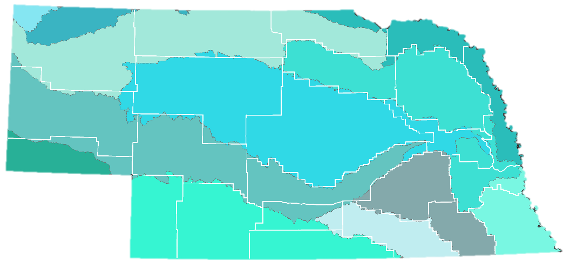
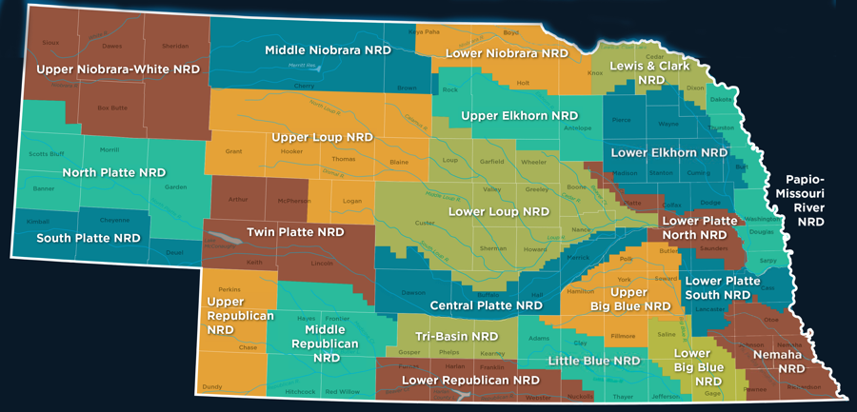
Keys to Success – Boundaries – Resource Area
46-715(2)(b) a map clearly delineating the geographic area subject to the integrated management plan
Surface Water Administrative Areas
Natural Resources Districts
Notes:
NRD Boundaries generally follow Surface Water Basin Boundaries
– defines the area subject to IMP goals, objectives and controls

Slide 14
Keys To Success – Boundaries – Authorized Users
Certification of Use
  Surface Water Permits
  Certified Groundwater Acres
Basin | SW Irrigation Permits | Irrigated Acres | Other Permits | Other Use Majority
Republican FA | 429 | 107,900 | 215 | storage
Upper Niobrara FA | 454 | 58,500 | 176 | storage
Upper Platte OA | 464 | 434,000 | 185 | storage
Basin | Total Irrigation Wells | Irrigated Acres | Other Wells | Other Use Majority
Republican FA | 9,800 | 1,021,500 | 5,500 | Domestic, monitoring, livestock
Upper Niobrara FA | 1,500 | 179,400 | 6,800 | Injection, monitoring, recovery, livestock
Upper Platte OA | 11,500 | 1,068,300 | 13,000 | Domestic, monitoring, livestock
Notes:
Certified Uses allows for easier quantification of the water uses, so that the goal of balancing uses and supplies can be evaluated and it allows for easier monitoring and enforcement.

Slide 15
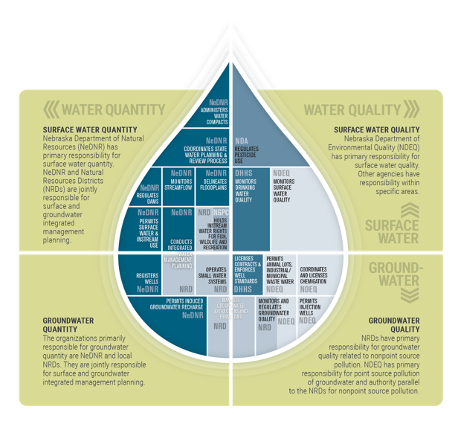
Keys to Success – Decentralized, Local Needs and Conditions
46-715(2): IMPs must contain one surface water control and one groundwater control
Required plans in water-challenged areas → directs efforts where its most needed
  NeDNR can designate areas fully appropriated through its “Annual Evaluation of Availability of Hydrologically Connected Water Supplies”
Voluntary plans in other areas → proactive water management
  Areas that have not designated fully or overappropriated are participating in voluntary IMPs
Notes:
There are a few ways in which Nebraska Statues provide for meeting local needs and conditions
1) Decentralized control (local NRDs)
2) Recognition that not all areas are in the same hydrologic circumstances (required and voluntary plan areas)
3) Local users choose their controls
Each NRD can chose their own control to implement the same goal – regulation or incentive based or other projects (Platte/Republican Examples)
Example – upper platte – meters/allocation vs conjunctive mgmt
Statutes provide a toolbox of options

Slide 16
Keys to Success – Nested Tiers
IMPs must keep the State in compliance with Interstate Agreements, Compacts, Decrees (46-715(4)(b))
Basin-wide Plans: Joint development, adoption and implementation – multiple NRDs and NeDNR
IMPs: Joint development – Plans require joint development, adoption and implementation between state-level surface water managers (NeDNR) and one local groundwater manager (NRD)
Notes:
IMPs – BWP – Interstate Agreements
Allows for the ability to comply with Interstate Agreements, while allowing the specific controls on how this works to be set by local members who are subject to the rules.

Slide 17
Keys to Success – Dispute Resolution
Dispute resolution procedures – Basin-Wide Plans
Upper Platte Basin
  Any water user can initiate
  Investigate hydrologic impact
  Basin-wide issue:
    Conduct an investigation
    Revise plan
  Portion of the basin:
    Work with the affected users
    Develop solutions
Republican Basin
  Any water user can initiate
  Evaluate conflict and potential solutions
    Weigh hydrologic, economic, and environmental impacts
  Address conflicts
  Modify plan
Notes:
Dispute resolution procedures contained in BWPs
Included as a Response to Stakeholder Input for Plan Actions
Basin-Wide Plans reviewed at Annual Meetings – where Disputes will be discussed
Allows for ongoing input of those water users subject to plan goals, objects and controls

Slide 18

Keys to Success – Funding Opportunities
Local
  NRD Local Tax Authority
  NRD Occupation Tax on Irrigated Lands
State
  Water Resources Cash Fund
  Water Sustainability Fund
  Nebraska Environmental Trust
Federal
  Platte River Recovery Implementation Program
  Partnering with NRCS, USFWS, USGS, NPS
Photo from http://www.citrusbirdingtrail.com
Notes:
Required Areas - Nebraska’s Water Resources Cash Fund
Fully and overappropriated areas
For projects to:
Reduce consumptive use
Enhance streamflow
Enhance groundwater recharge
Voluntary Areas – Nebraska’s Water Sustainability Fund
Eligible to NRDs with IMPs
Created strong incentive for voluntary IMPs
WRCF $3.3M / year today + $3.3M NET funds
Water Planning Division for studies and planning needs. $400,000 / year today +current staffing levels 17 FTEs ~ $1.5M annually
WSF – $10M / year
NET – funded by lottery proceeds – in 2019 awarded $20M

Slide 19
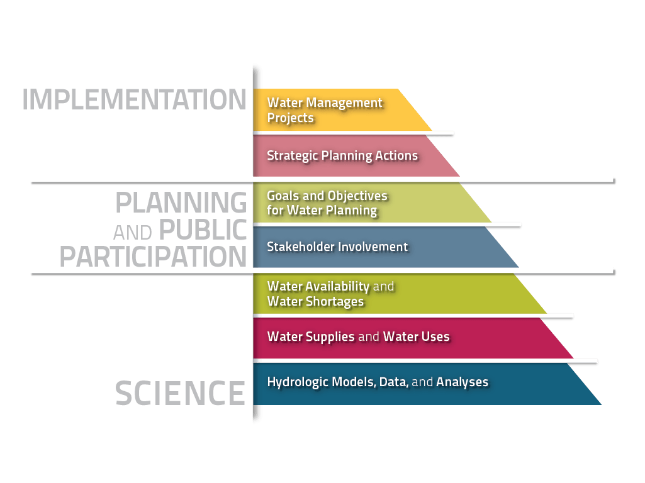
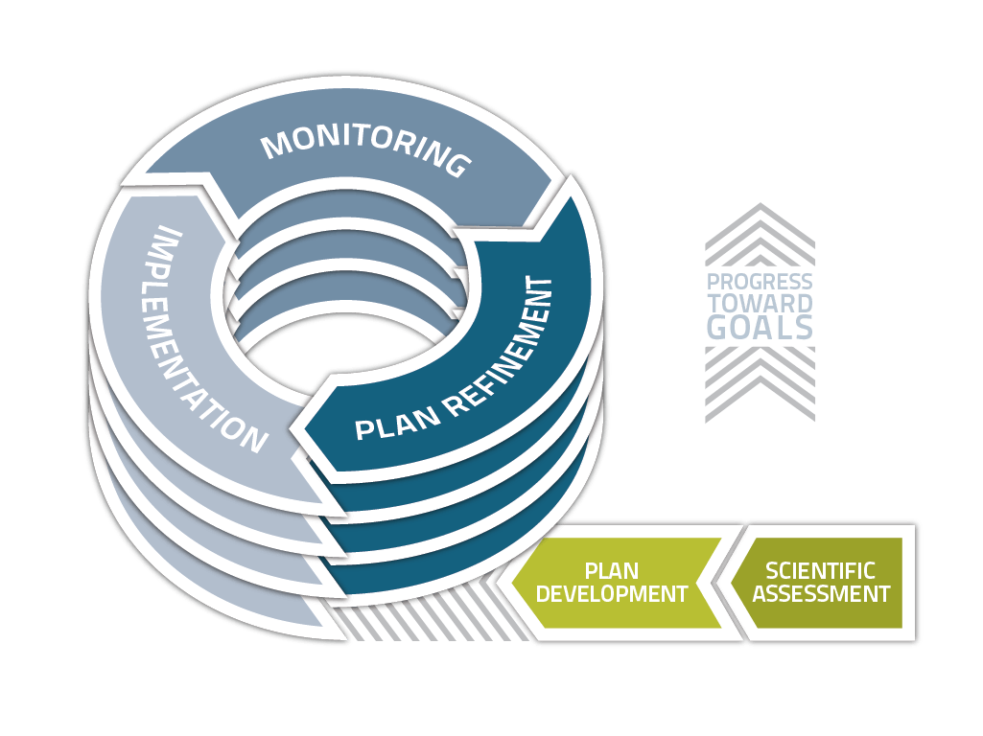
Keys to Success – Monitoring and Process
46-715(2)(e) a plan to gather and evaluate data, information, and methodologies [to implement, increase understanding] and test the validity of the conclusions and information [of the plan]
Notes:
Another key principle is that of ongoing Monitoring. In Nebraska this is mandated in statute. This focus on ongoing monitoring and evaluation of plan goals, objectives and actions, requires a foundation of science - for decision making – including basic data, and complicated hydrologic models of the integrated surface and ground water system. Building on this is the public participation step of the planning process – where stakeholders are engaged and the plan goals and objectives are developed. Then the plan is implemented and monitored. The monitoring process includes public meetings where stakeholders can discuss the progress being made toward the goals. The implementation process includes Partnership opportunities for Stakeholders/water users to work jointly with an NRD and/or DNR to implement plan action items like Conjunctive Management Projects with Canal Companies and Reservoir Owners, Active Streamflow Augmentation projects, and incentive based efforts to reduce Consumptive Use (multiple funding partners, Ducks Unlimited, Rainwater Basin Joint Venture, NRCS, etc).
And the process does not stop there –
Implementation and monitoring leads to plan refinement and new public processes with stakeholders.
This iterative and adaptive management process is an important principle of Nebraska Integrated Water Resources Management.
We learn as we go along, and we adjust to new understandings of the resource.

Slide 20
Keys to Success – Stakeholders (education)
46-715(5)(b) & 46-755(5)(c) [IMP shall be developed after consultation and collaboration with stakeholders]. If agreement is reached by all parties…, the [NeDNR and NRDs] shall adopt the [plan]. & 46-717(2) [NeDNR and NRDs] shall consult with [stakeholders].
Component of IMP and basin-wide plans
Stakeholders help formulate, evaluate and recommend goals, objectives, and action items
Stakeholders provide local insight, local concerns, and opportunities
Notes:
Saved stakeholder for last – as it is, in my opinion one of the most important principles of success of IWRM in Nebraska
In Statutes it is mentioned in 3 separate locations – for different types of plans
required basin-wide plans
and required IMPs
In each case the idea is that stakeholders are part of the process for development of the goals, objectives and actions contained within the plans
Example Group Sizes – 10 to 40
Stakeholder meetings are like a large classroom – where there is learning by all parties sitting at the table – including us regulators – learning about the local needs.

Slide 21
Keys to Success – Stakeholders
Statute specifies key interest
groups as stakeholders:
NeDNR and NRDs can also
choose to include others:
Irrigation districts
Reclamation districts
Public power districts
Mutual irrigation or canal companies
Municipalities
NGOs
Other water users
Groundwater users
Range livestock owners
NE Game and Parks
Notes:
Stakeholders represent the various local water user interest groups

Slide 22
Keys to Success – Stakeholders
Stakeholder groups have improved relations among water users through effectively managed communication
Prior to IWRM statutes:
  Conflicts between surface water and ground water users did not have a clear legislative method for resolution and therefore lawsuits were the only option
After IWRM statutes:
  Stakeholder processes in plan development, ongoing monitoring, reporting, annual meeting processes and implementation projects, contained within the IMPs allow for more accessible and lower cost dispute resolution. Stakeholders work together, learn, and help shape water plans to reduce or eliminate conflict over time
Notes:
Stakeholders build understanding and trust through effectively managed communication – FACILITATION
Upper Platte BWP – examples
survey – great facilitator
Republican BWP – examples
change in facilitator called for by stakeholders
Stakeholder Surveys – show they build relationships between water users and the regulators! And is one of the things the participants appreciated most – hearing the other guys perspective!

Slide 23
Plan development process
DNR/NRD Collaboration
Public Involvement
Initiate Plan Development
Stakeholder Invitations
Develop Goals & Objectives
Consult with stakeholders
Develop Action Items
Continue to engage stakeholders
Draft Plan
Reach consensus
Hold Public Hearing
Consider testimony
Adopt Plan, Publish Orders
Plan Implementation
Annual Public Meetings
Annual Public Meetings
Notes:
Stakeholder Roles:
Convey local water issues/concerns
Guide development of goals and objectives
Disseminate information to local groups about IMP
Attend meetings
NRD / DNR Roles:
Acquire/disseminate information/data needed for stakeholder process
Help formulate goals and objectives with stakeholders
Coordinate with each other, stakeholders, facilitators throughout process
Help determine/convey feasible actions for plan implementation
Write the Integrated Water Management Plan
Implement the Plan
Public Hearing:
Additional Public Input
NRD and NeDNR consider testimony
Adopt plan with or without modifications

Slide 24
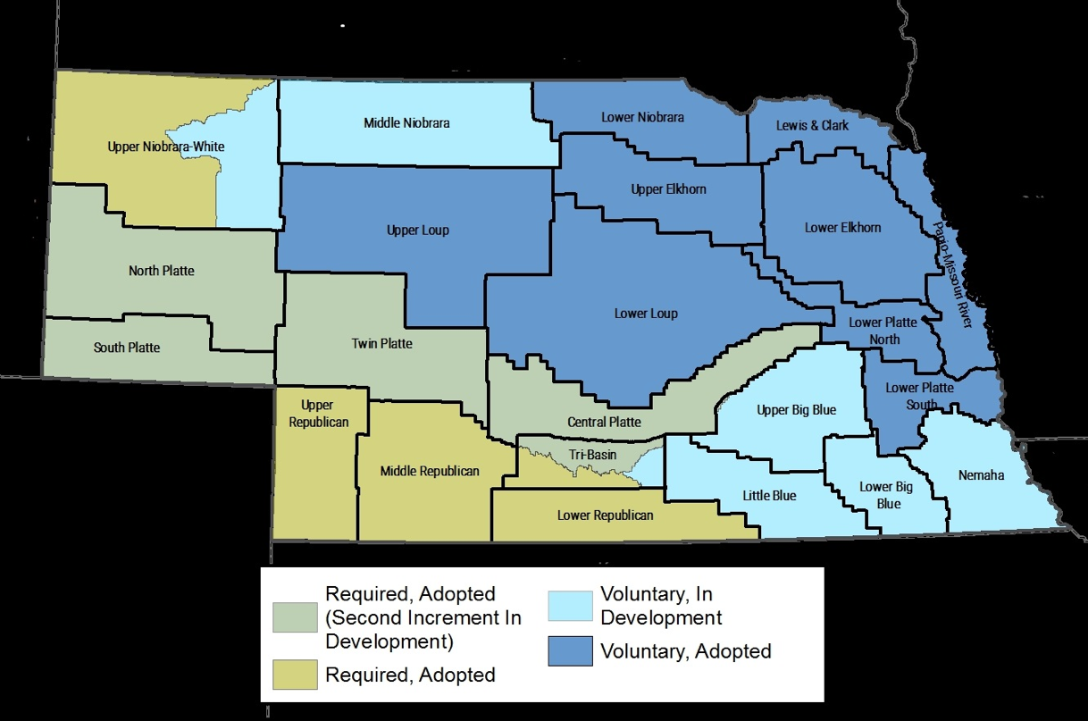
Integrated Management Plans (IMPs) Developed 2004-2019

Slide 25
Basin-Wide Integrated Management Plans 2009-2019

Slide 26

Projects to Achieve Plan Goals
    Data Collection and Analysis
    Education
    Conjunctive Management Projects
    Groundwater Retiming Projects
    Regulatory Actions
    Retiring Land from Irrigation
    Drought Planning
Notes:
All Plan areas have components of data collection and analysis, as I discussed in the monitoring section earlier – this the critical science foundation component of the planning process. And matched with that is ongoing educational efforts of the public and basin stakeholders.
For Plan areas with water shortage issues, where supplies and uses are not always in balance, the other plan projects are necessary, such as, Conj Mgmt, GW retiming, Regulation, Retirements and Drought Planning – though we are moving toward more proactive drought planning in less water stressed areas of the state as well.
Conjuncitve Management in the Platte River Basin has been one of our most successful projects.

Slide 27
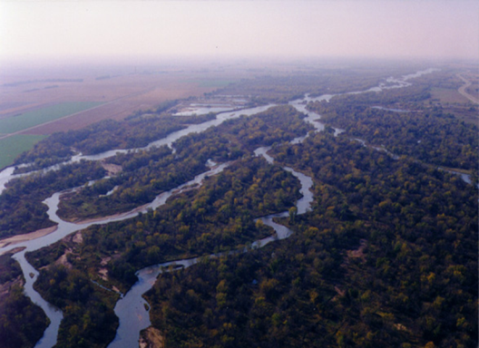
Summary of Flood Flow Diversions in the Platte River Basin
Over 200,000 acre-feet of excess flood flows diverted since 2011
Resulting recharge nearly 100,000 acre-feet
Accretions will benefit Platte River flows for many years into the future
Process in place for future successes

Slide 28
Concluding Thoughts
Challenge: separate regulatory systems for surface and groundwater
Legislative Toolbox
  Boundaries
  Local Needs and Conditions
  Nested Tiers
  Dispute Resolution
Trust and Communication – be impeccable with your word
  Funding
  Monitoring
  Stakeholder Participation
Article in the May 2019 AWRA Water Resources IMPACT magazine
Notes:
Nebraska started with two very different regulatory systems for SW and GW
brought together by IWRM in 2004
With the tools already present in the Nebraska Water Management system and those added from 2004- 2014 for IWRM, Nebraska has a legislative toolbox with options to meet both local needs and state requirements for interstate agreements, providing methods other than lawsuits for surface and groundwater users to address disputes and to increase understanding and trust. Many of these tools are consistent with those principles outline by Elinor Ostrom in her work outlining the “Principles for Managing a Commons”.
One of the most important aspects of successful integrated water resources management is perhaps something that cannot be legislated – building TRUST!
Ongoing communication and transparency are critical to building TRUST among water users and regulators – and this is really driven by those participating in the process – regulators and water users alike.

Slide 29
Jennifer J. Schellpeper
Water Planning Division Manager
jennifer.schellpeper@nebraska.gov
Notes:
Thank you!!!!

